Slide 1
Quantum Resources in Two-Level Systems Coupled to Harmonic Oscillators
Rowan Adeya
Supervisor: Prof. Alexandra Olaya-Castro

Slide 2
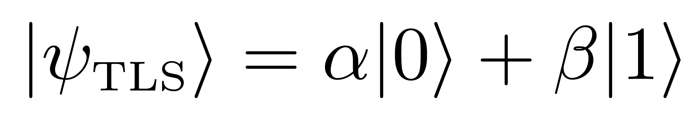
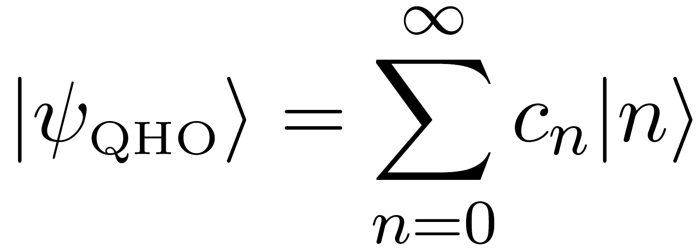
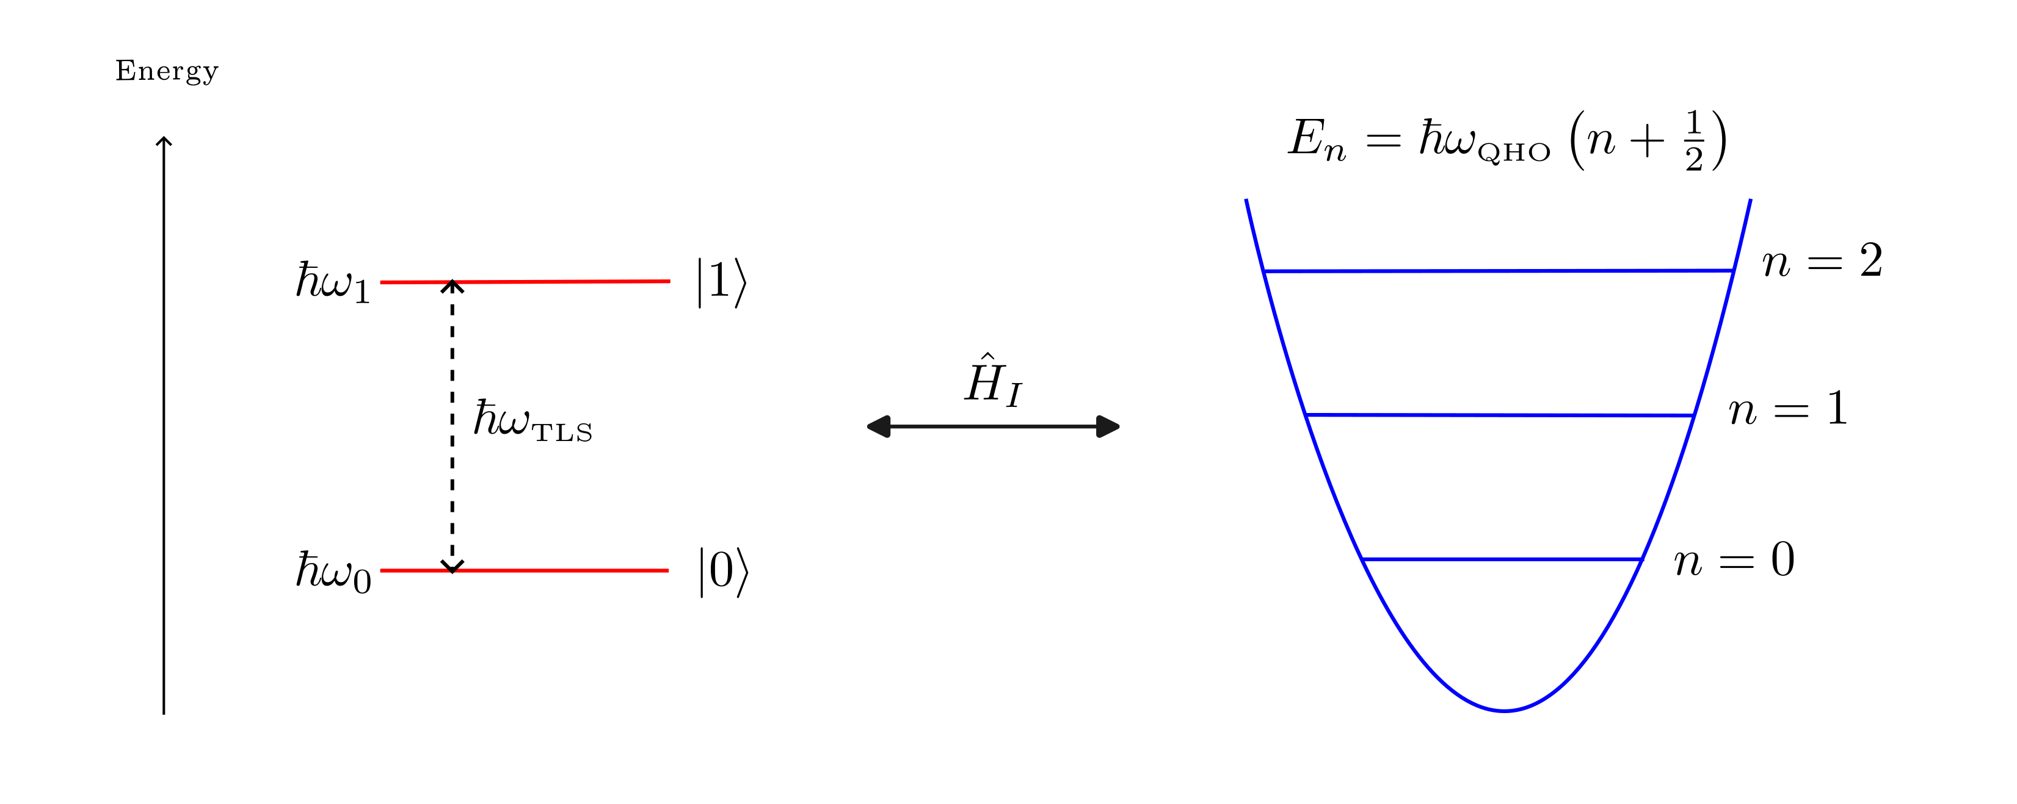
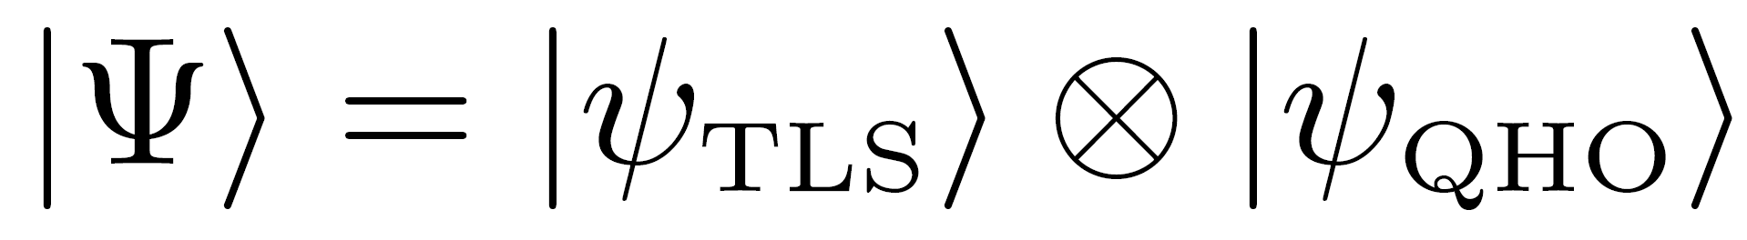
Two-Level Systems Coupled to Harmonic Oscillators
1
TLS
Any system with two possible states:
2
QHO
A system with spaced energy levels and a quantised energy spectrum:
1
2

Slide 3
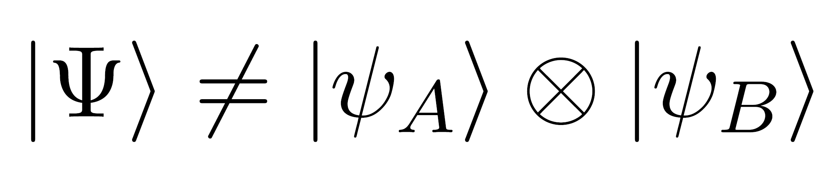
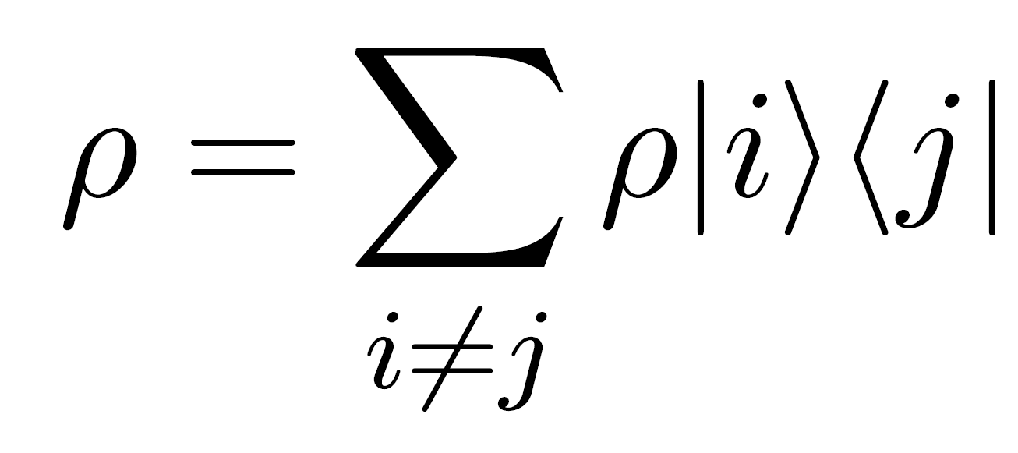
Quantum Resources: Entanglement and Coherence
Entanglement
Separability of a coupled system:
Coherence
Off-diagonal elements of the density matrix:

Slide 4
The Research Question
How do entanglement and coherence manifest in TLS-QHO systems?

Slide 5
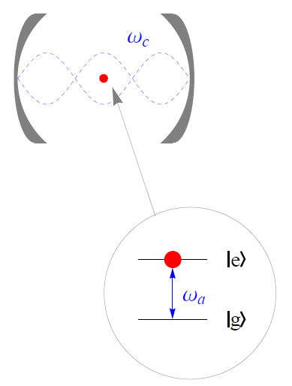
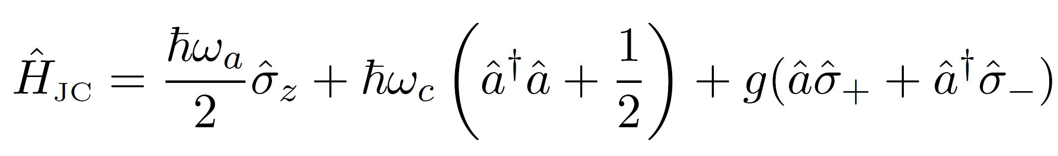
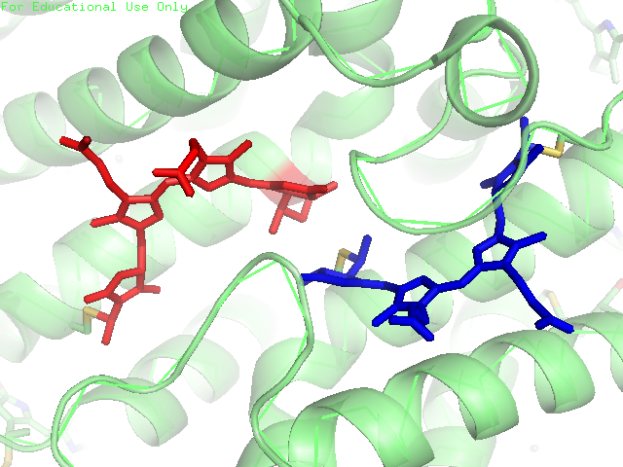
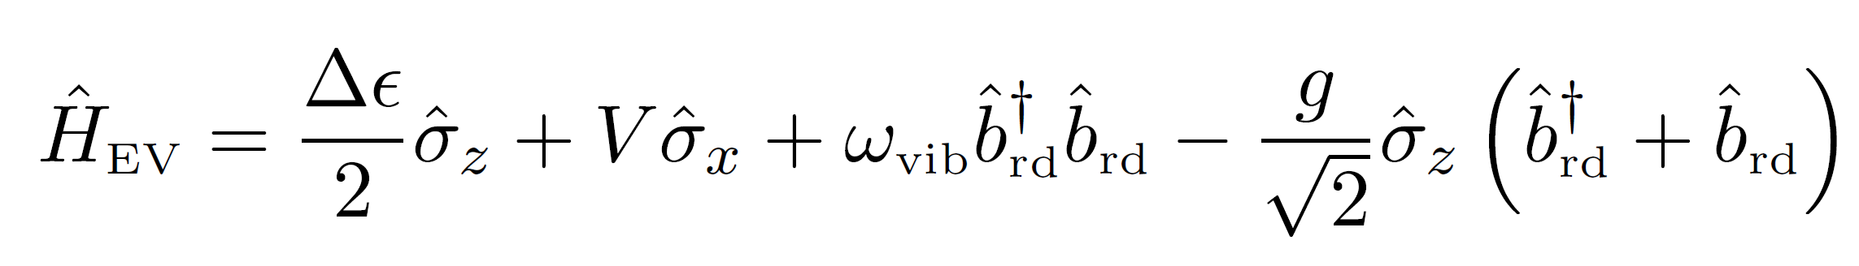
Methodology: Our Models
JCM
Single TLS coupled to one mode of a QHO. Simple, well-known dynamics.
EVM
Single effective TLS (dimer) , coupled to the molecular vibrations’ collective mode. More complex, intricate dynamics.

Slide 6
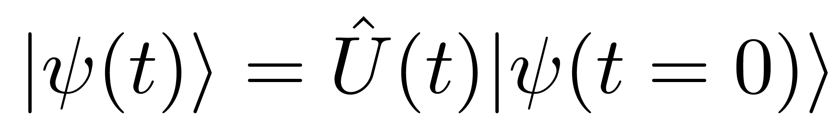
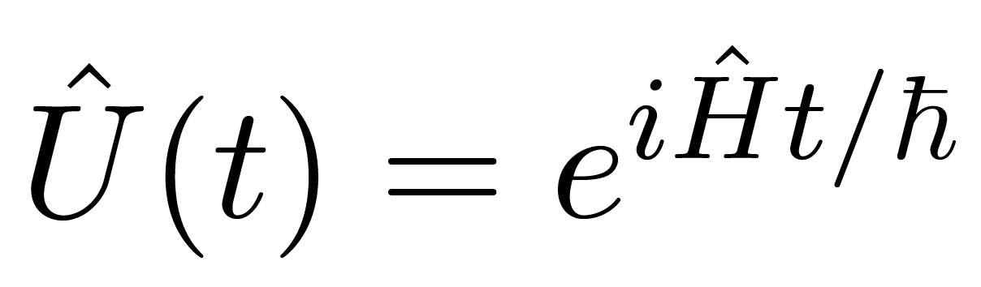
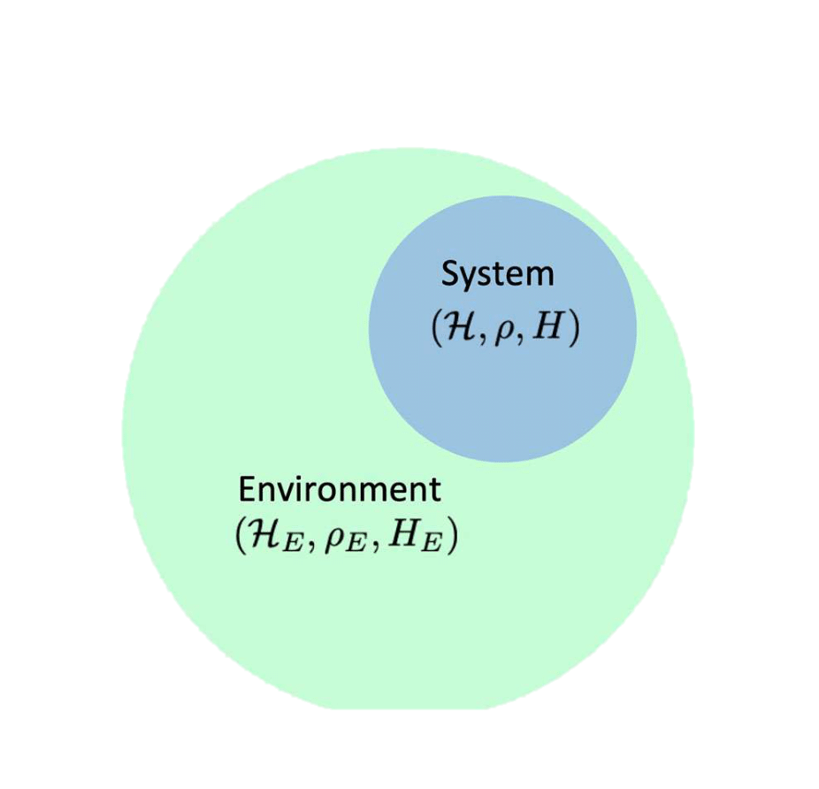
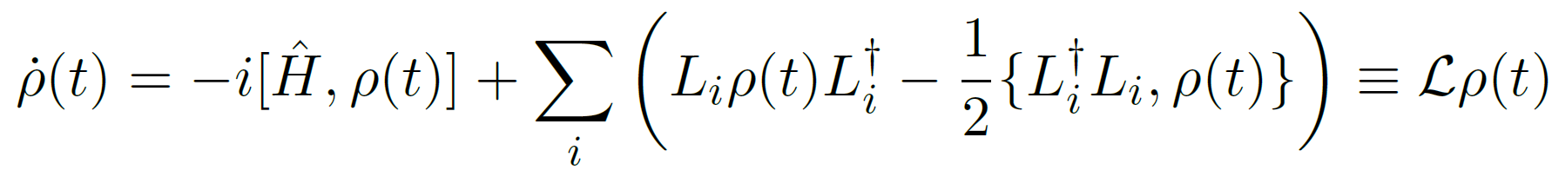
Methodology: State Evolution
Closed
Ignores the environment surrounding the system.
Open
Includes the effects of the environment in the total system.
Liouvillian superoperator
Decay operators
Spontaneous Atomic Emission
Thermal Dissipation (Temperature dependent)

Slide 7
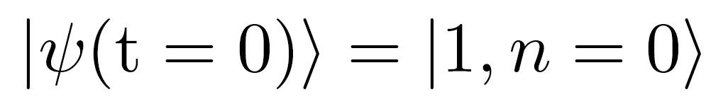
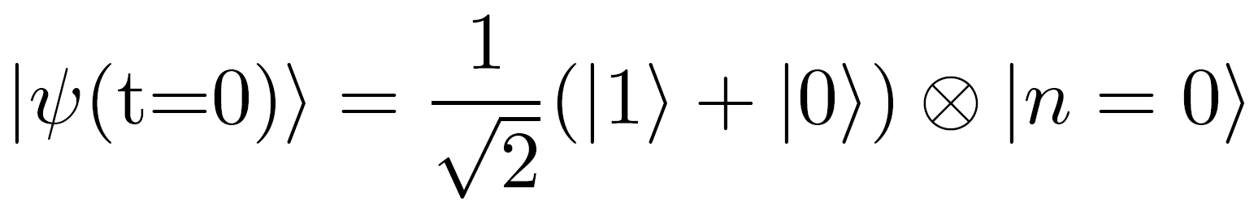
Methodology: Initial Conditions
Case 1
No subsystem superpositions.
Case 2
Superposition in the TLS subsystem, none in the QHO.

Slide 8
Methodology: Measures of Entanglement, Coherence
 | Entanglement | Coherence
Closed Evolution | Von Neumann Entropy | Relative Entropy of Coherence
Open Evolution | Negativity | Relative Entropy of Coherence

Slide 9
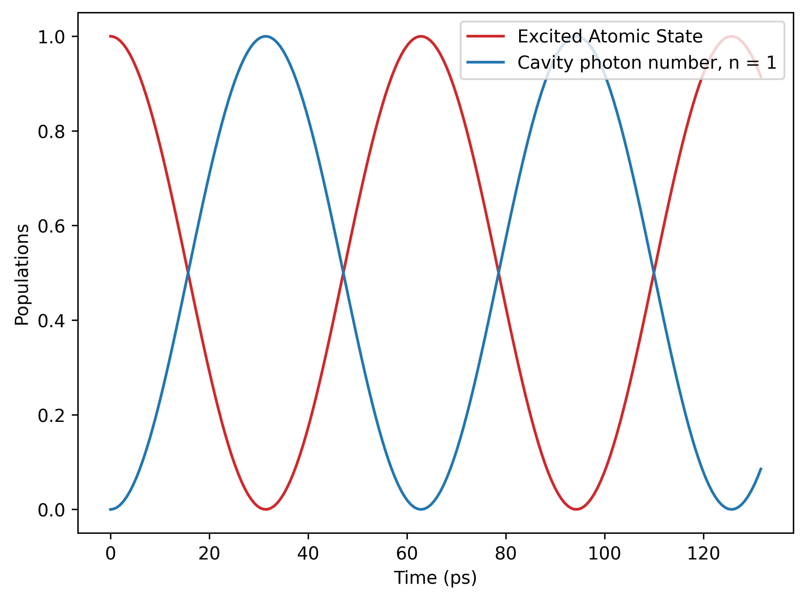
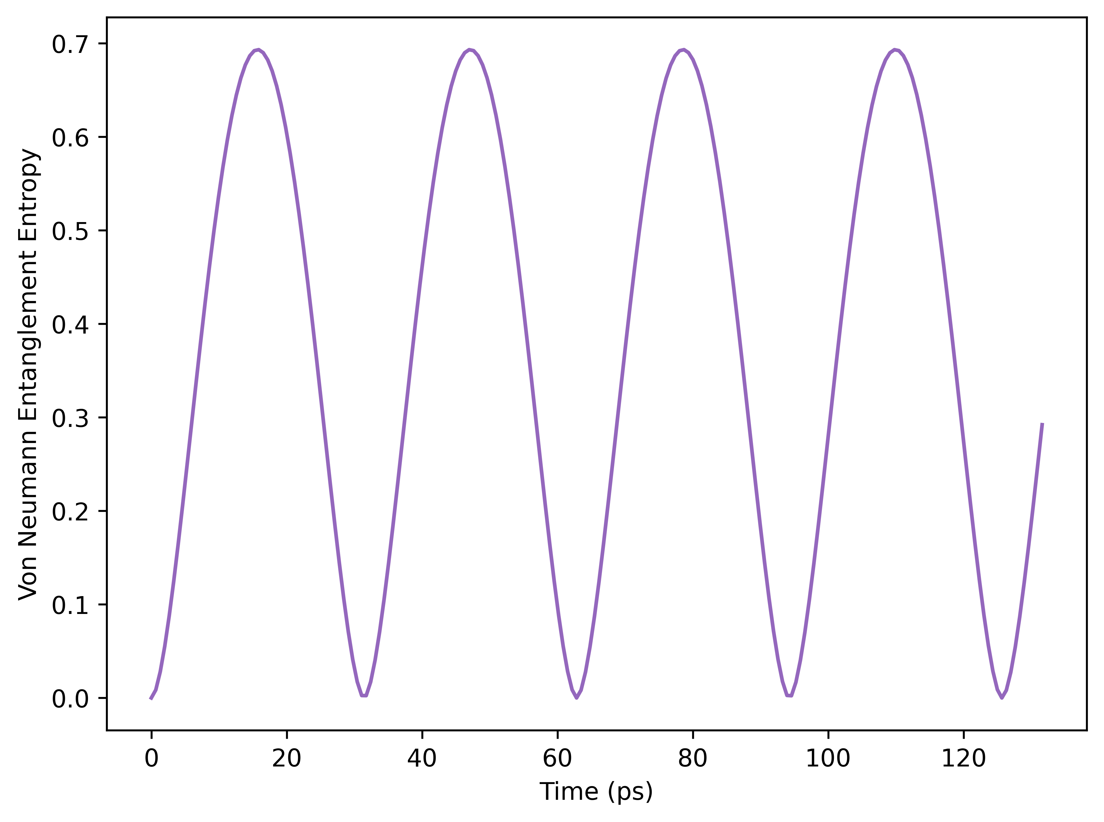
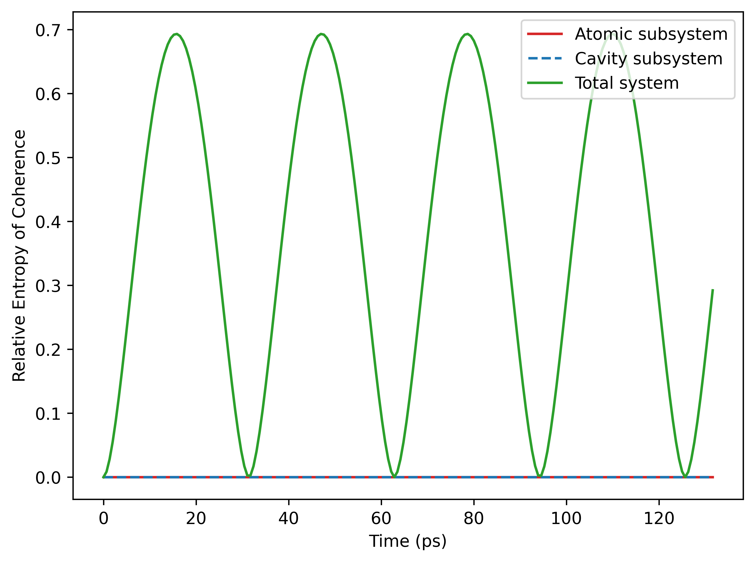
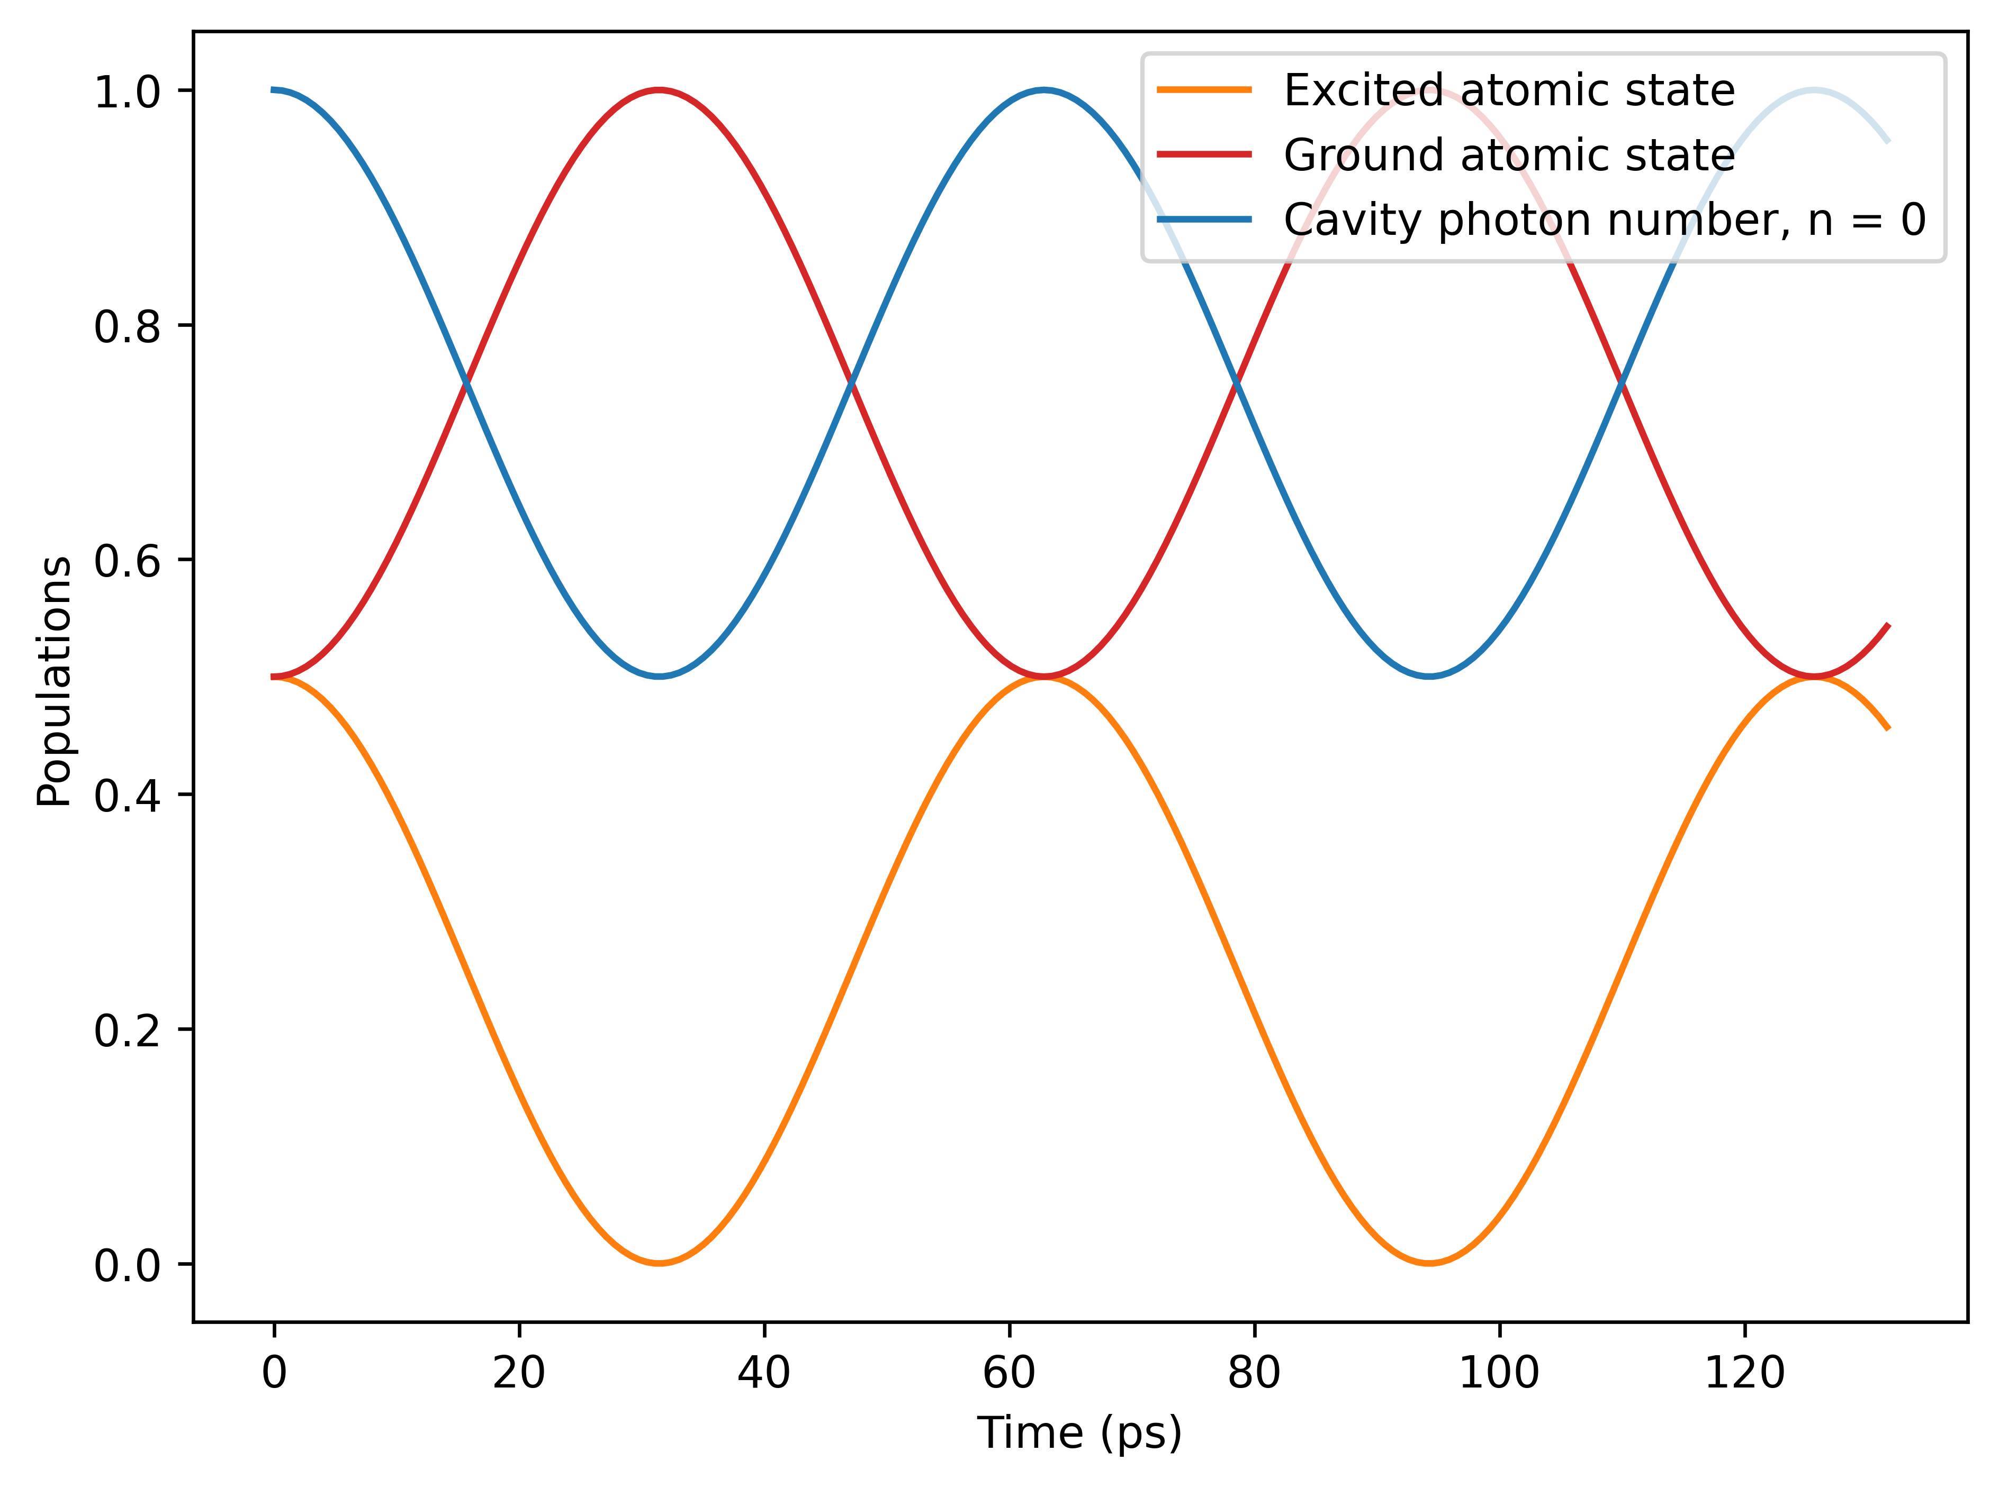
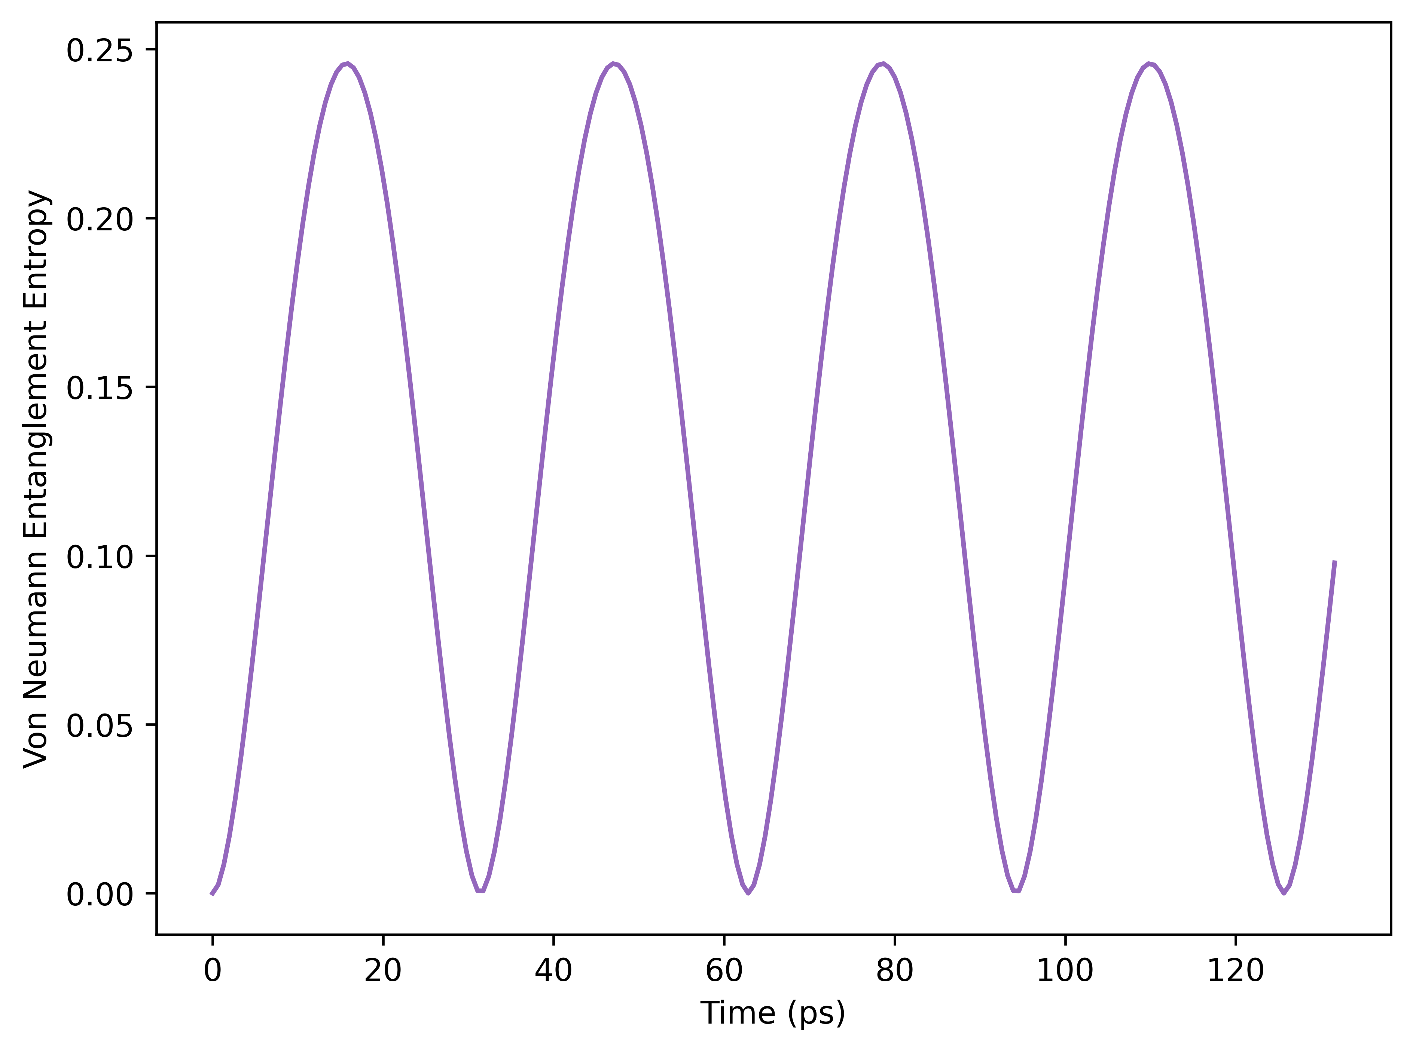
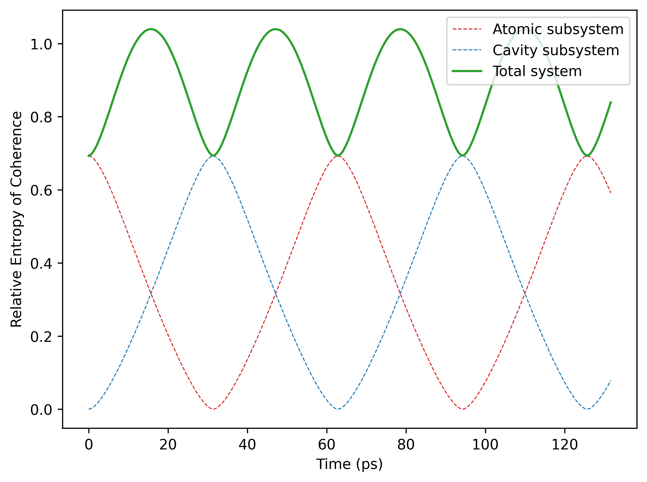
JCM: Closed Evolution
Case 1:
No coherence
Case 2:

Slide 10
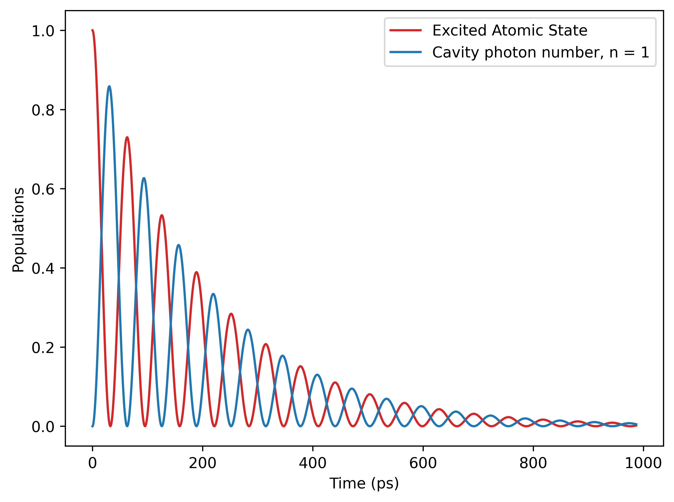
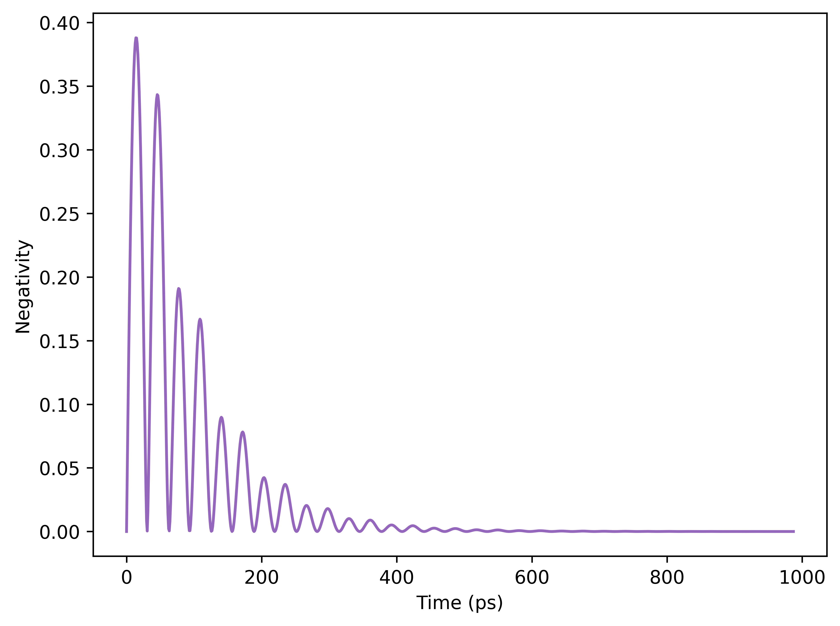
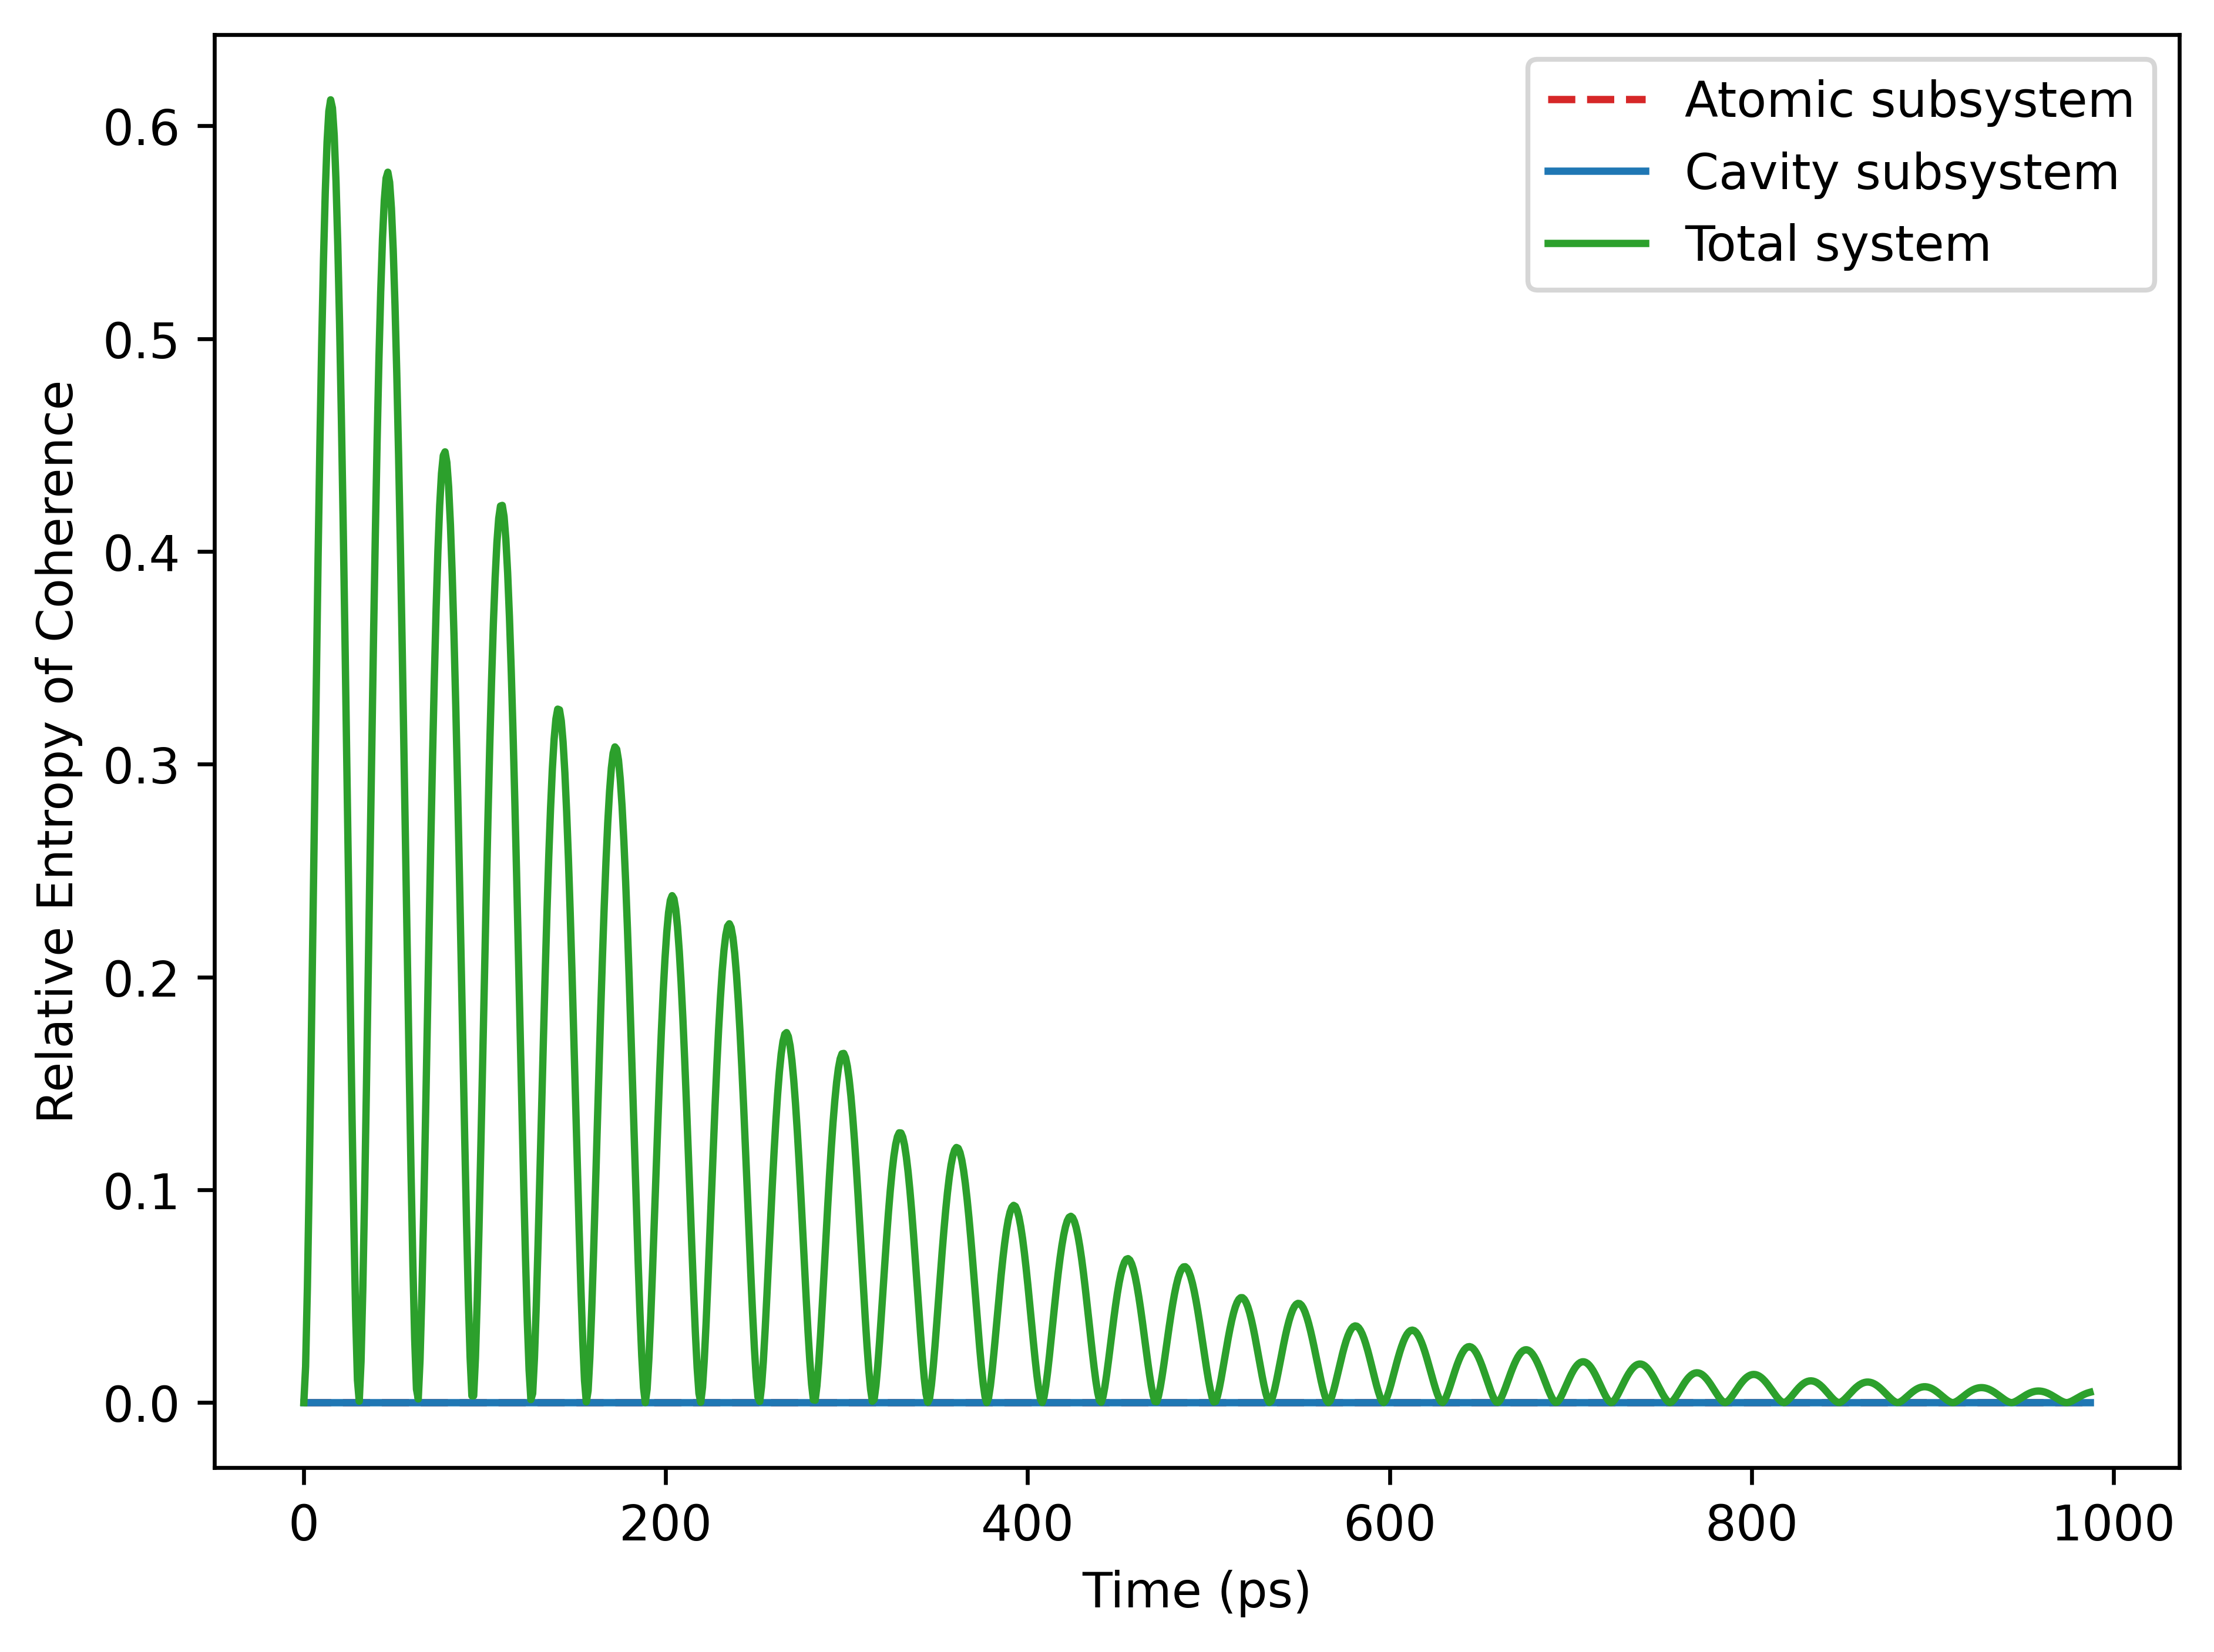

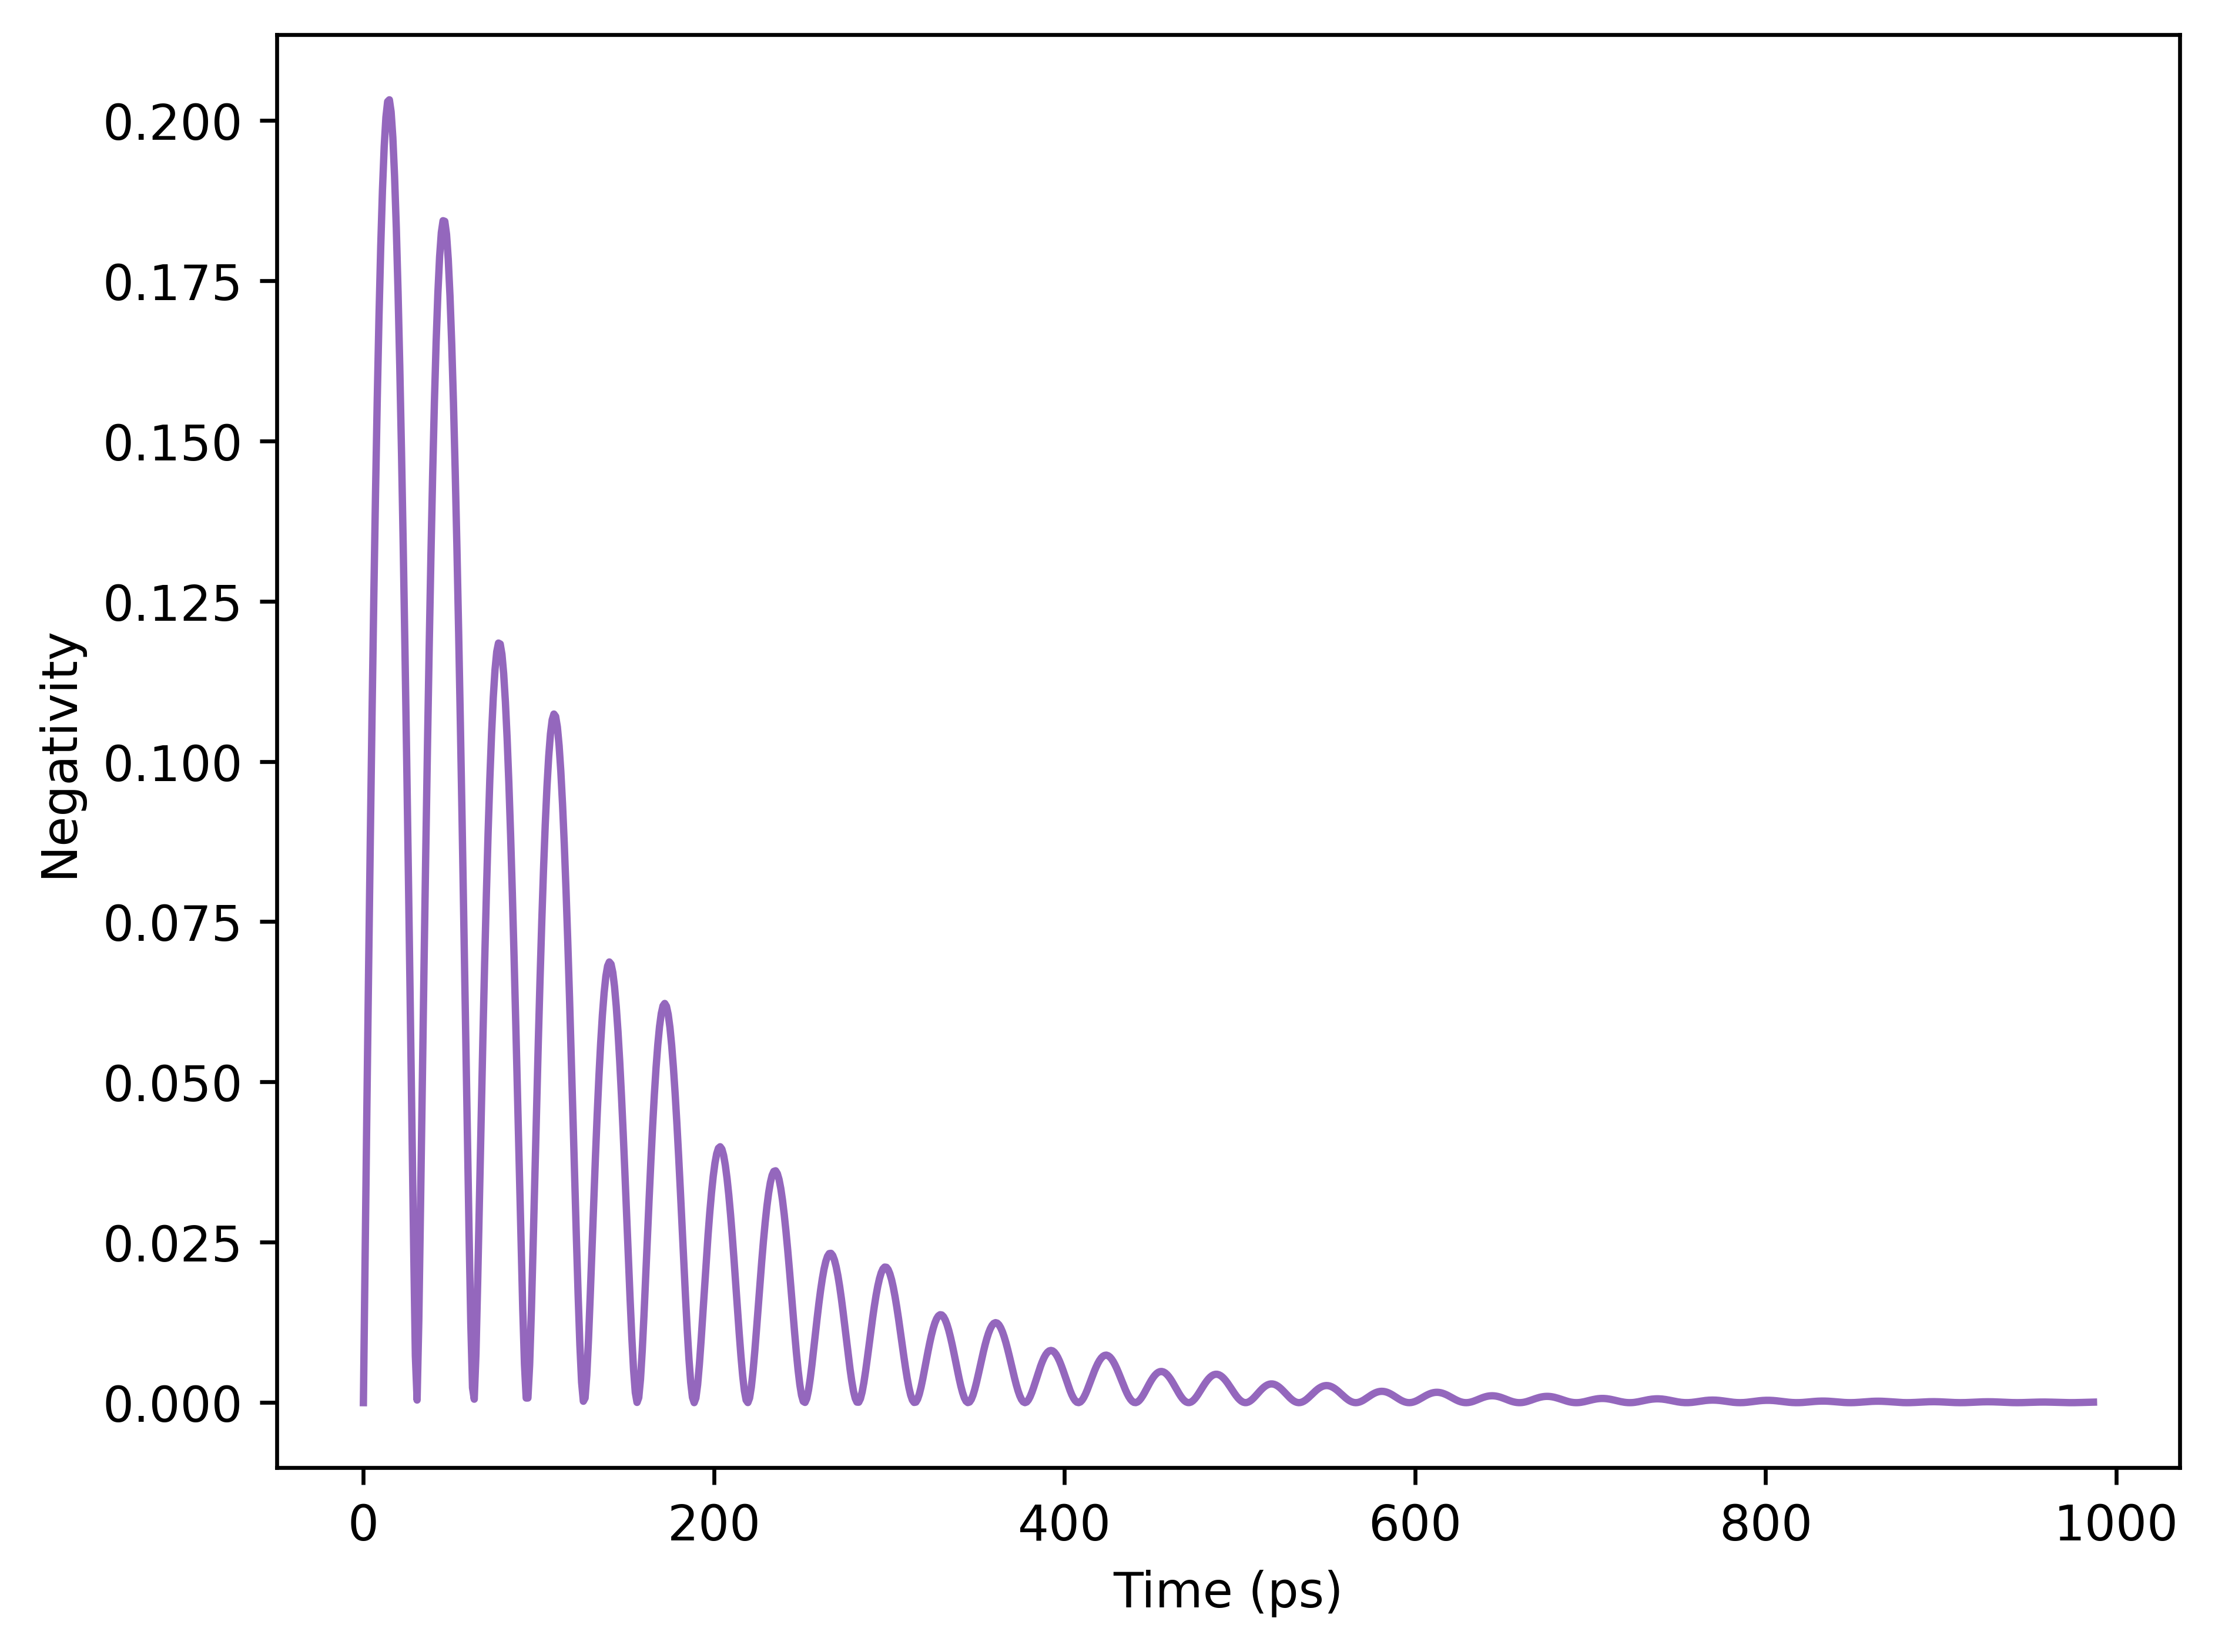
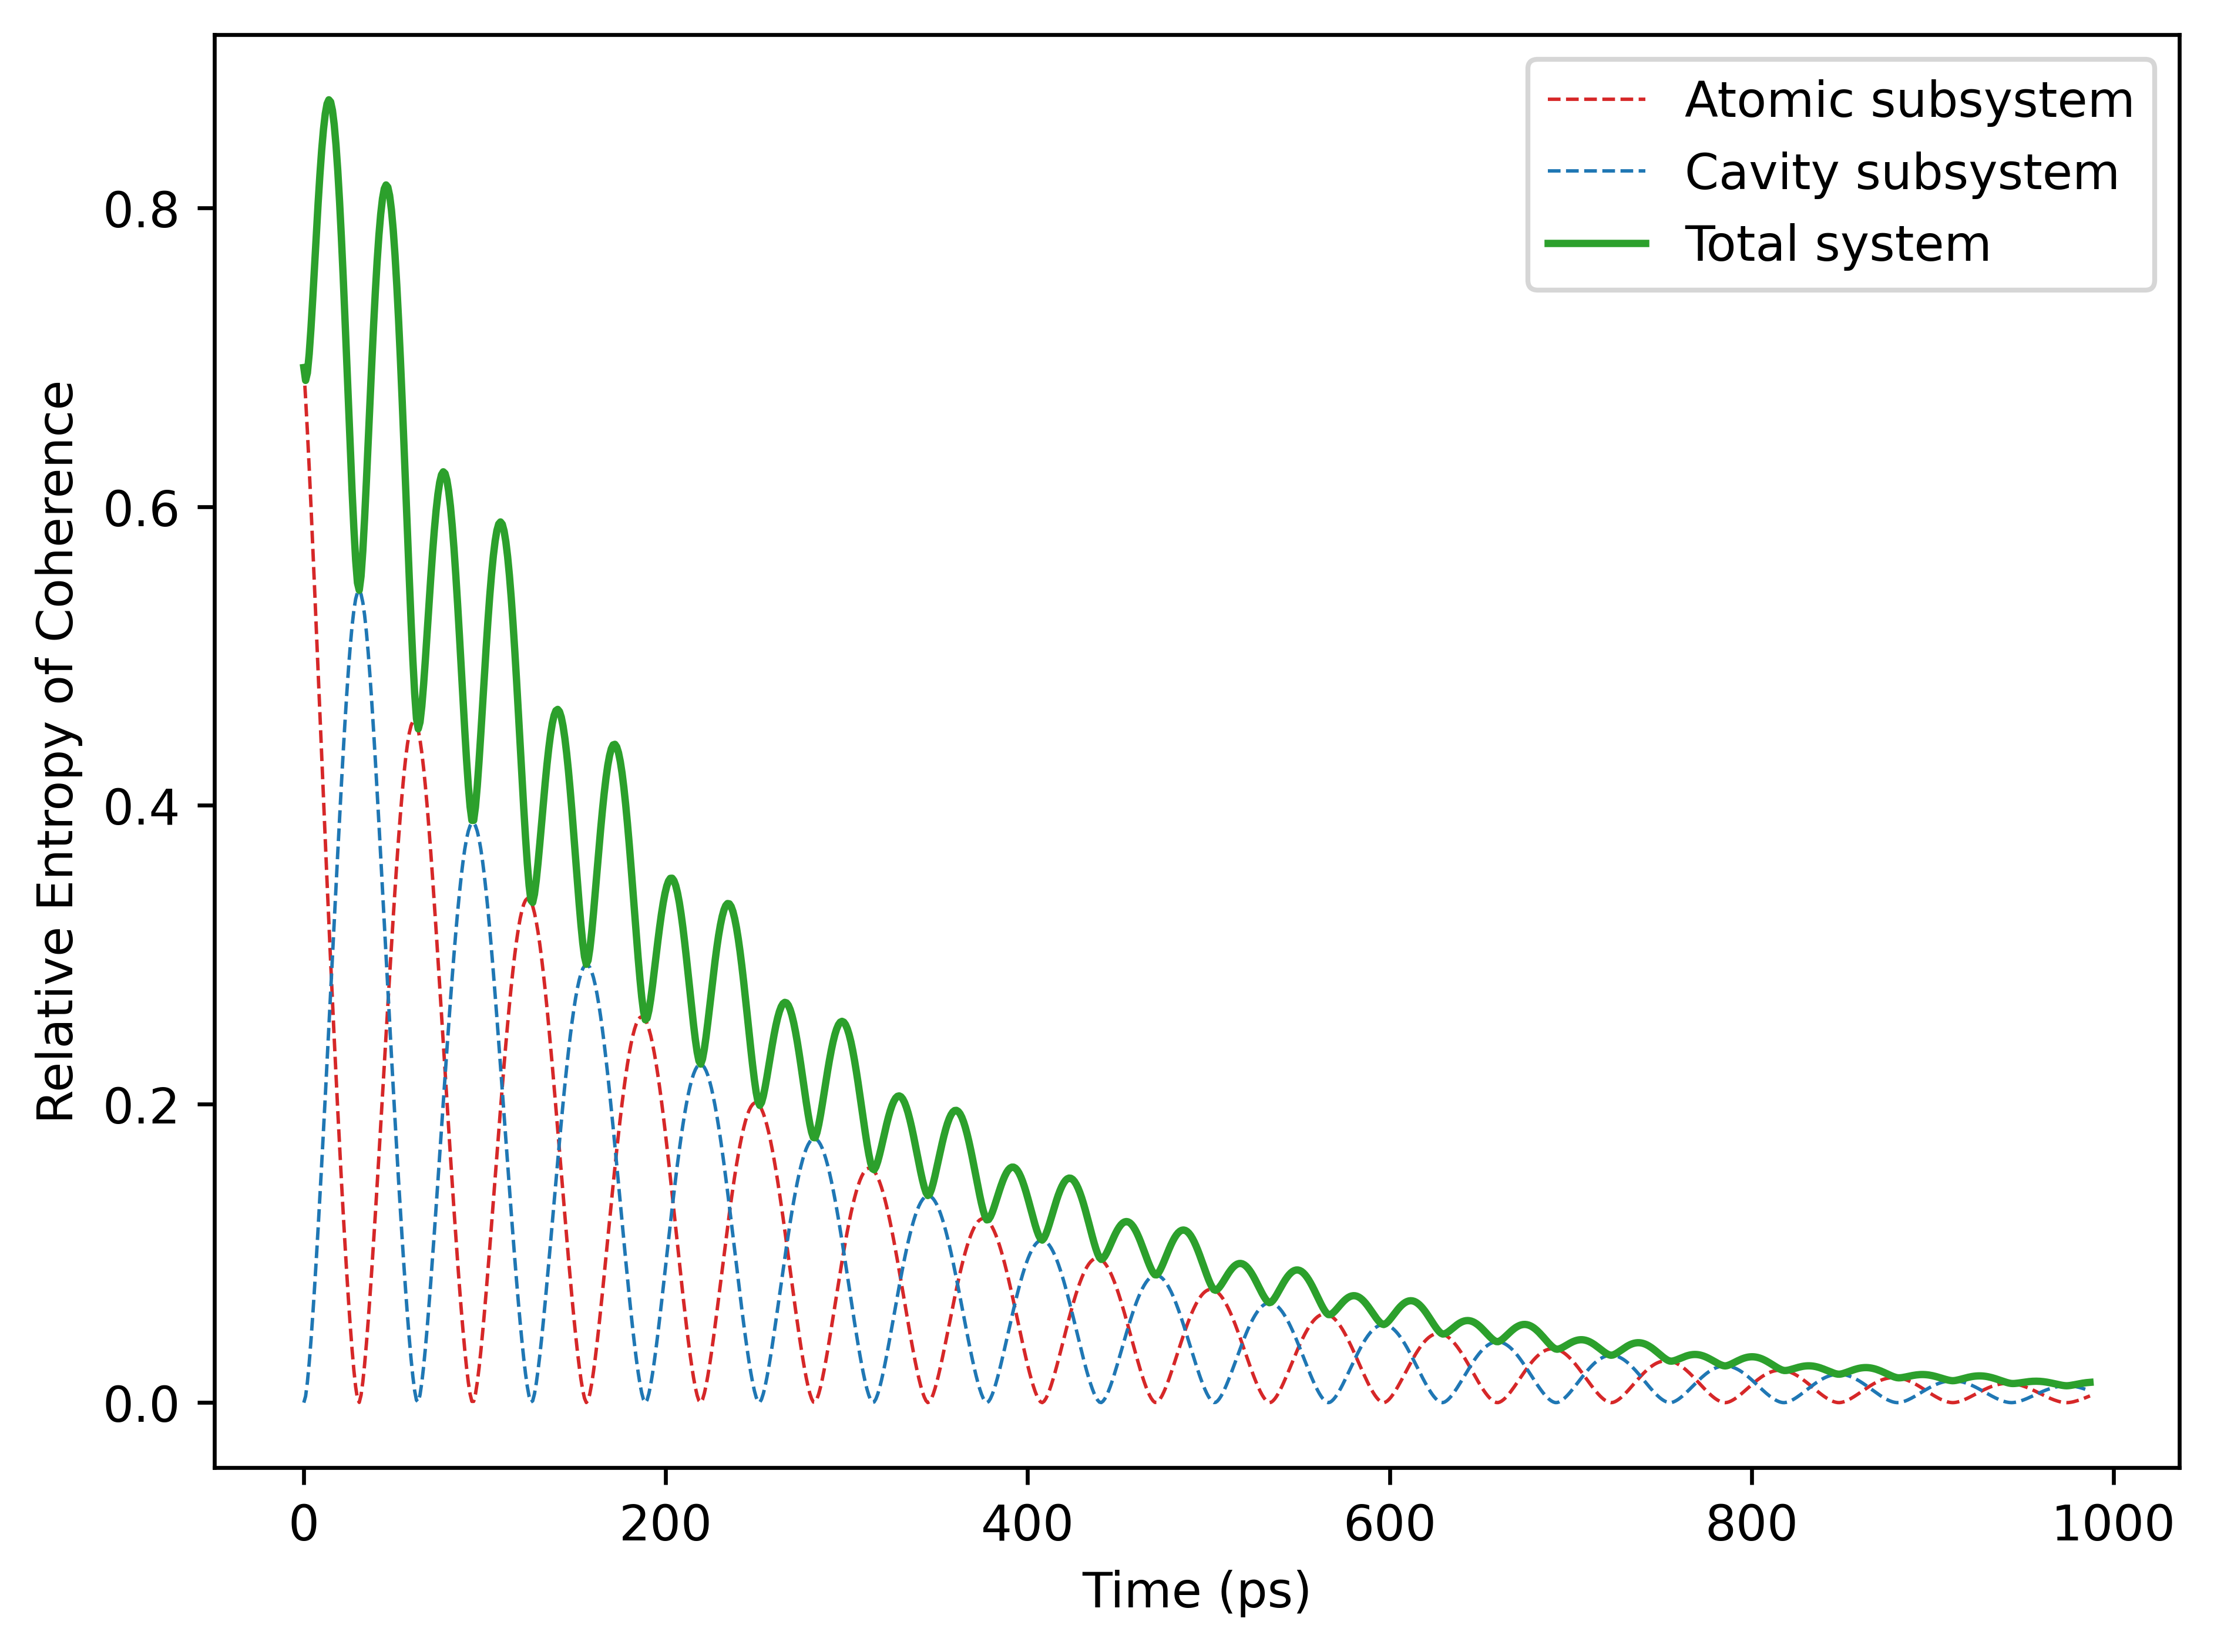
JCM: Open Evolution (Spontaneous Emission Only)
Case 1:
Case 2:

Slide 11
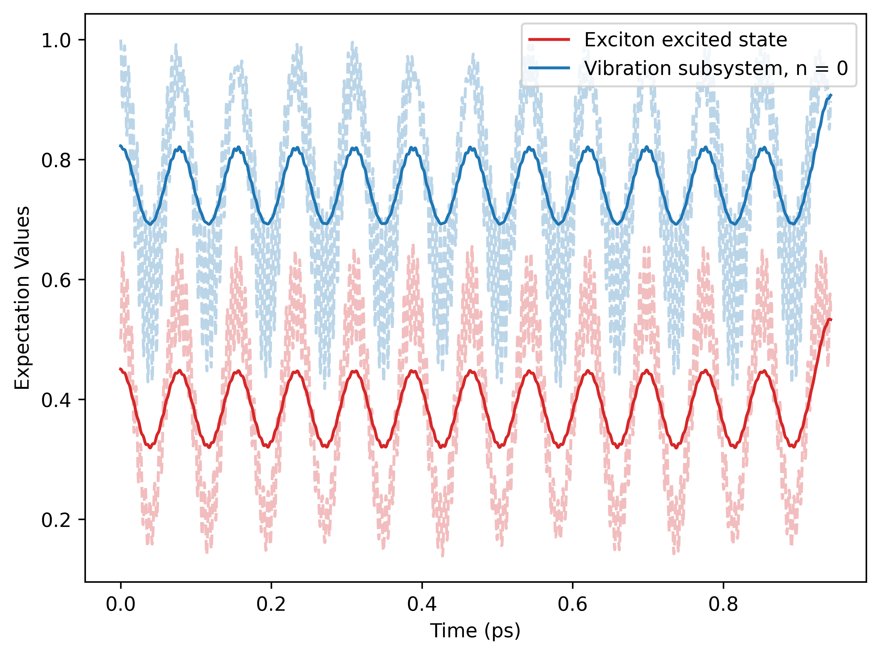
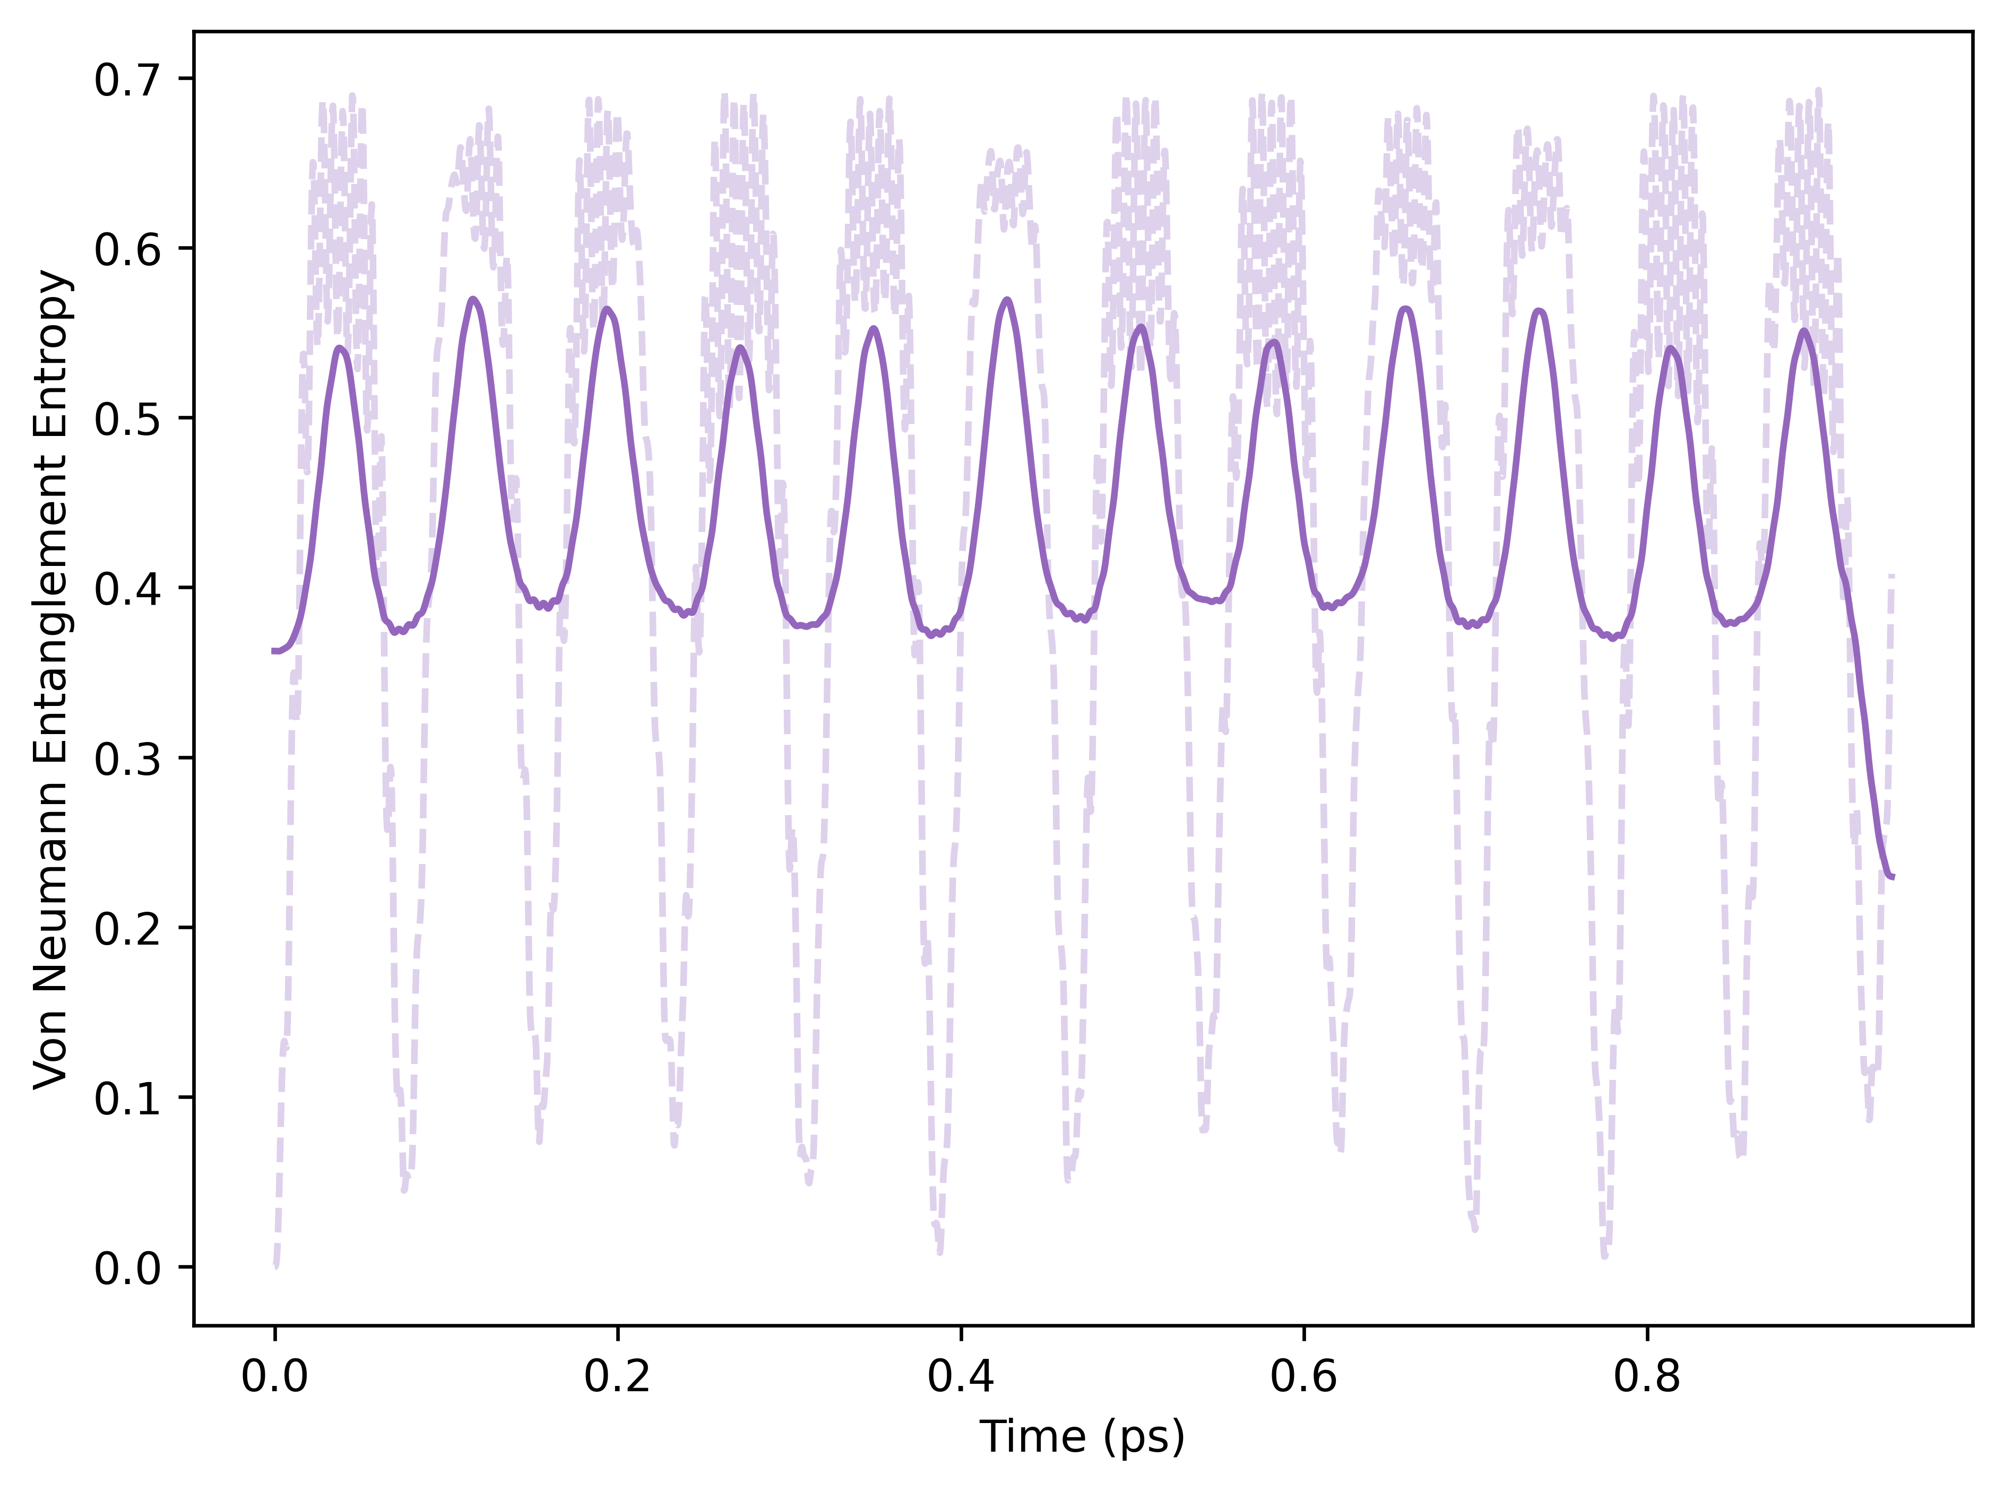
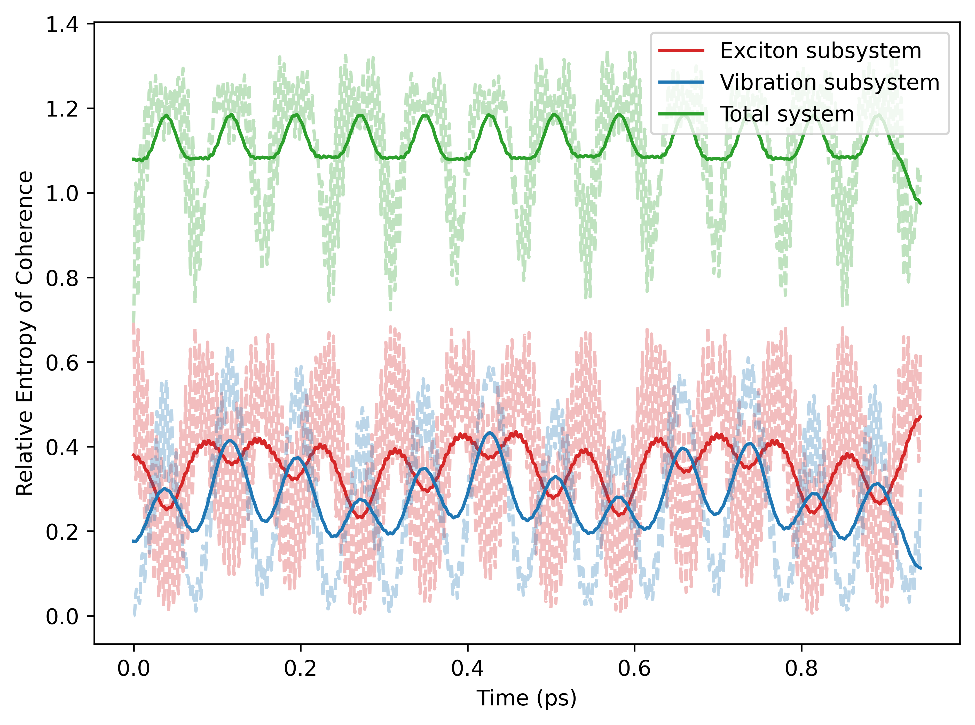
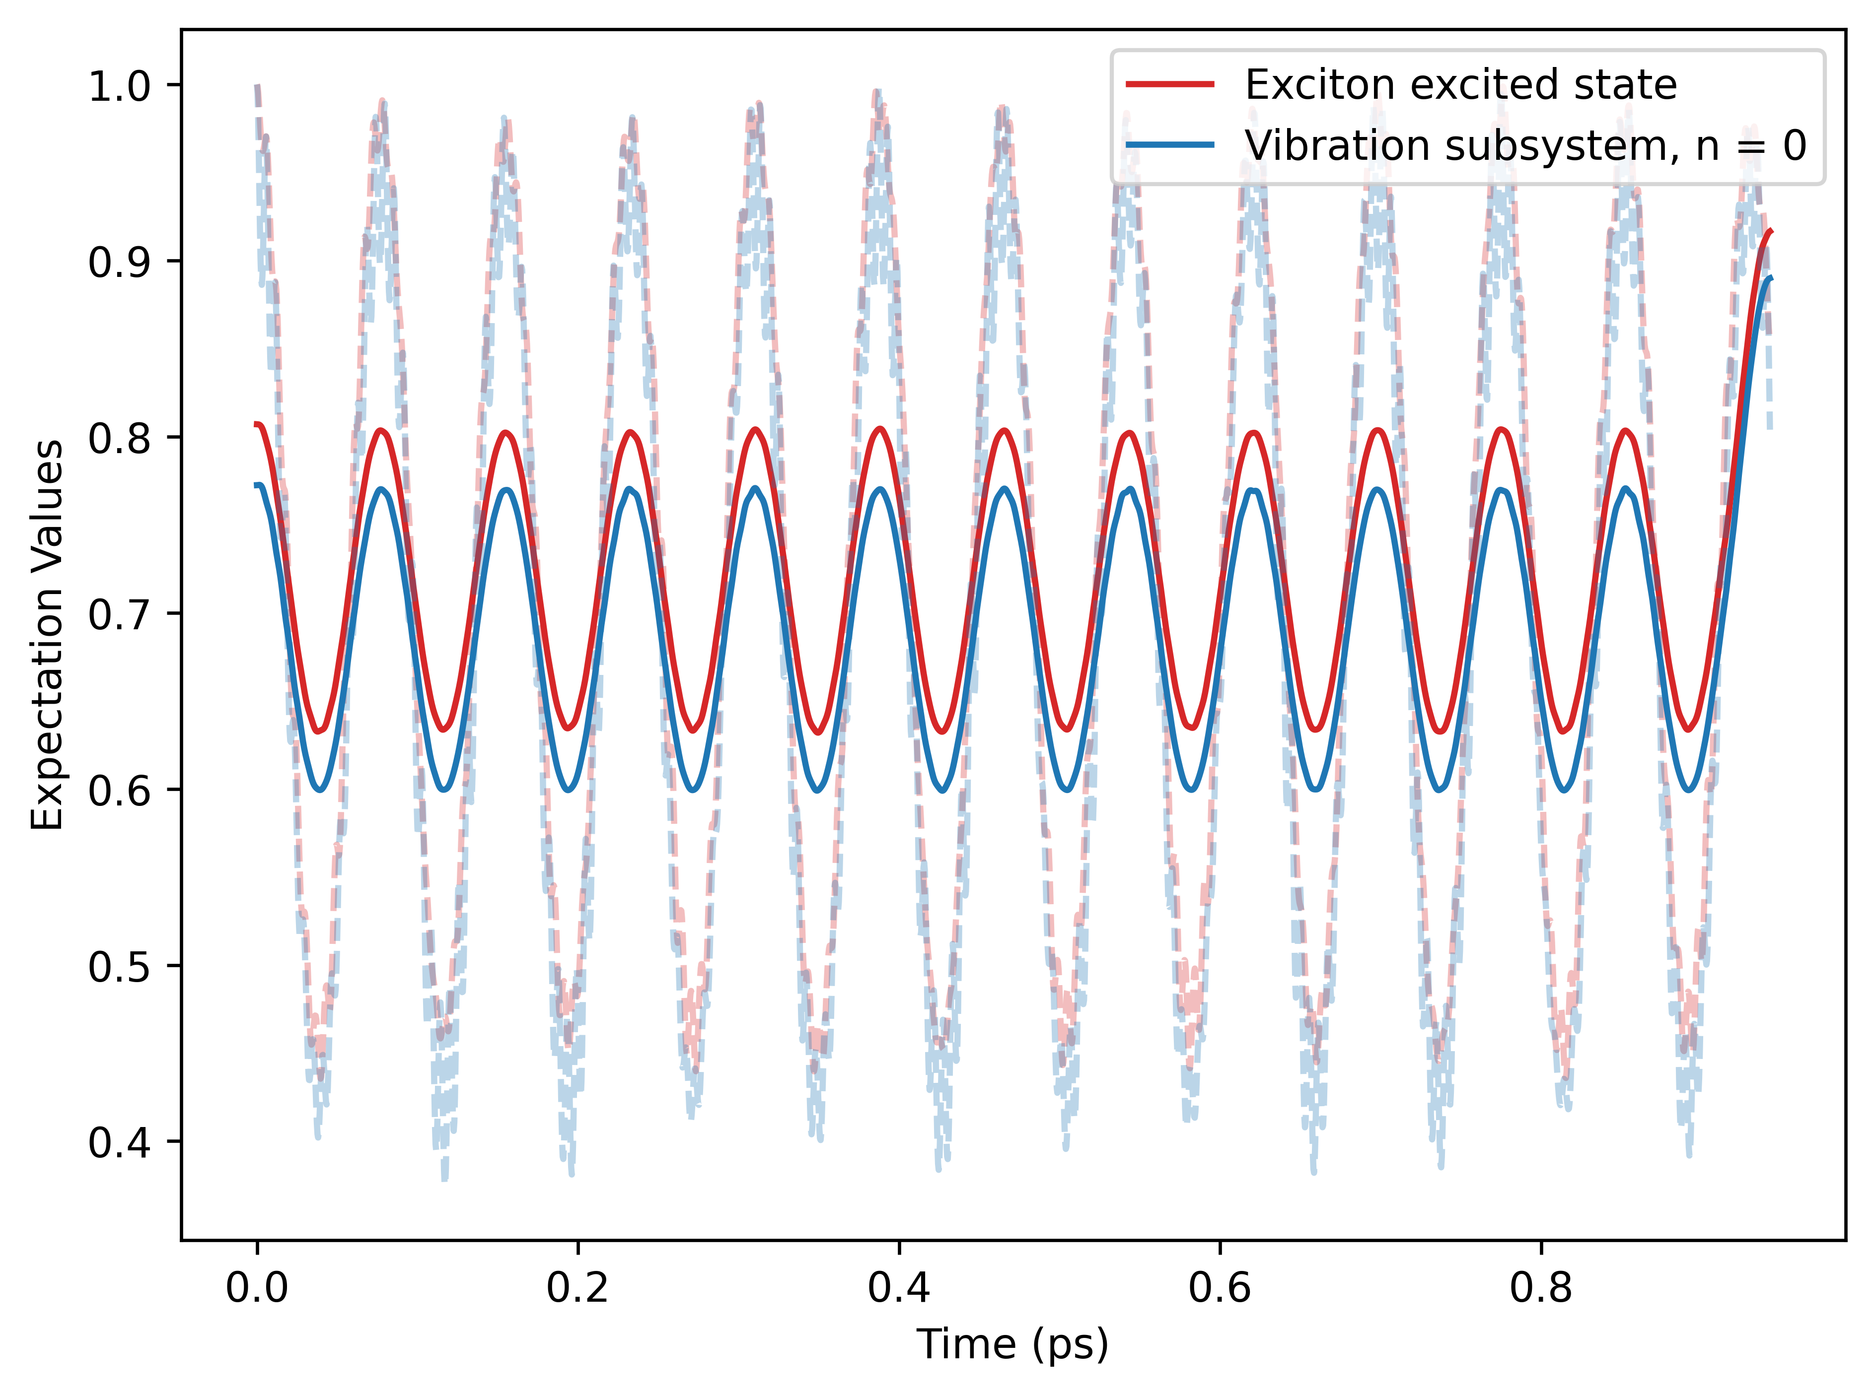
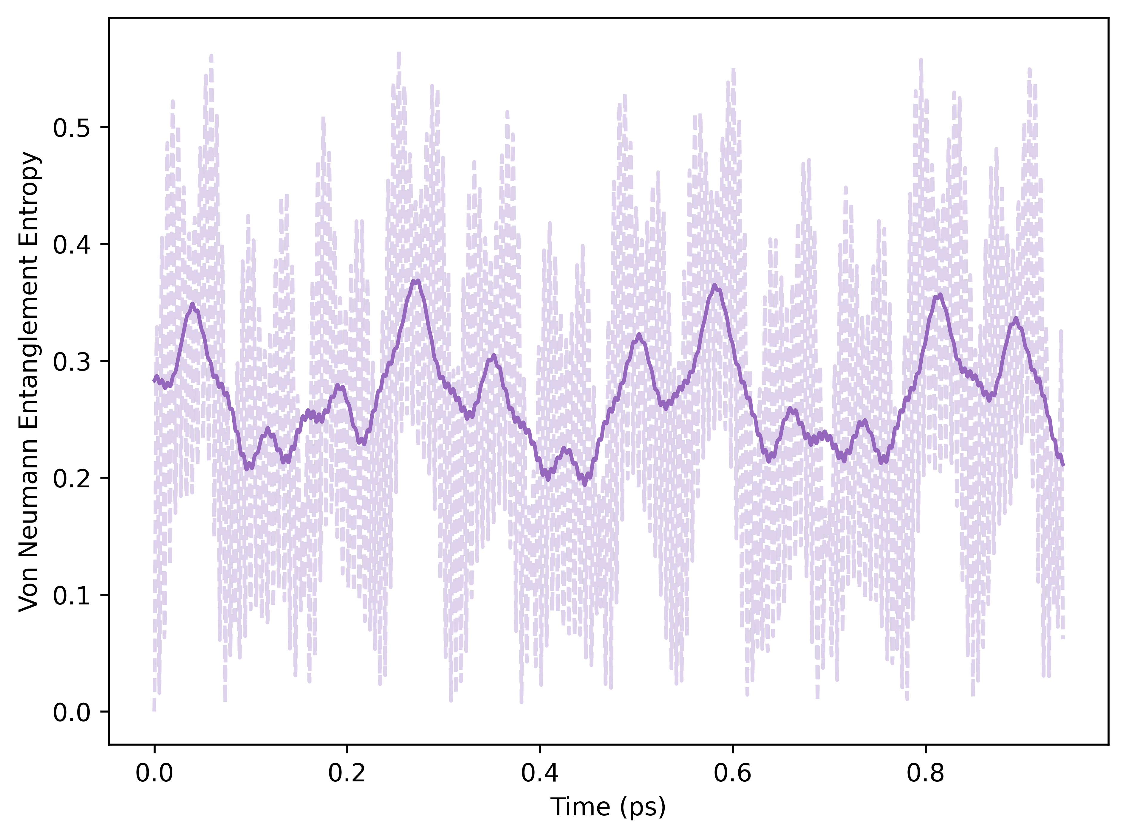
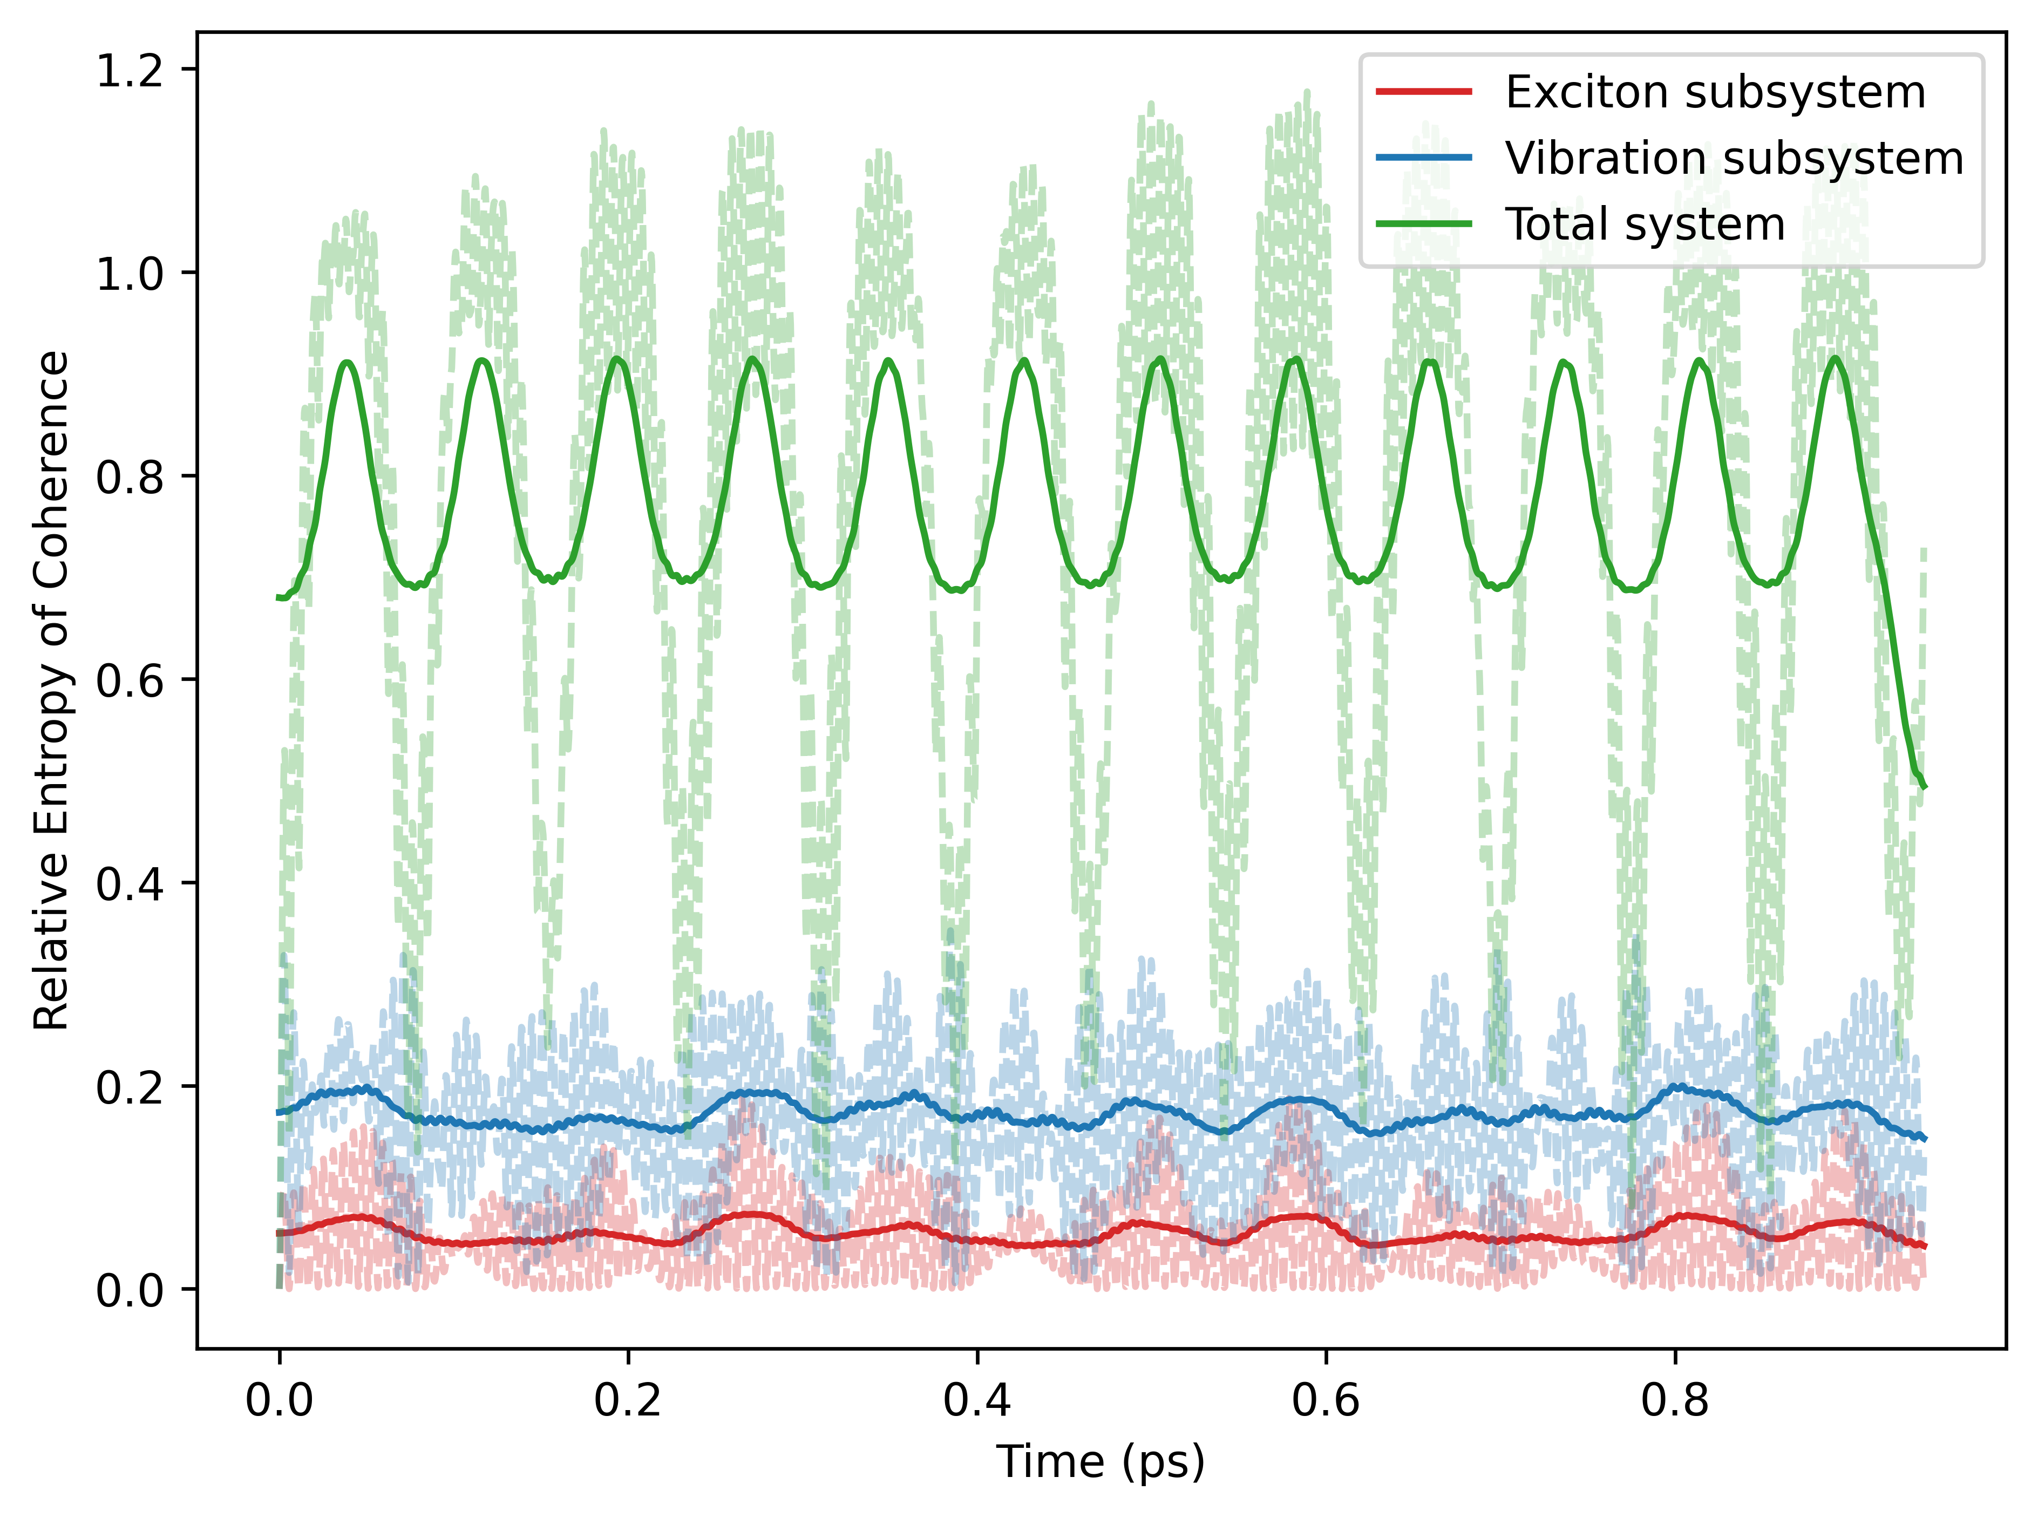
EVM: Closed Evolution
Case 1:
Case 2:

Slide 12
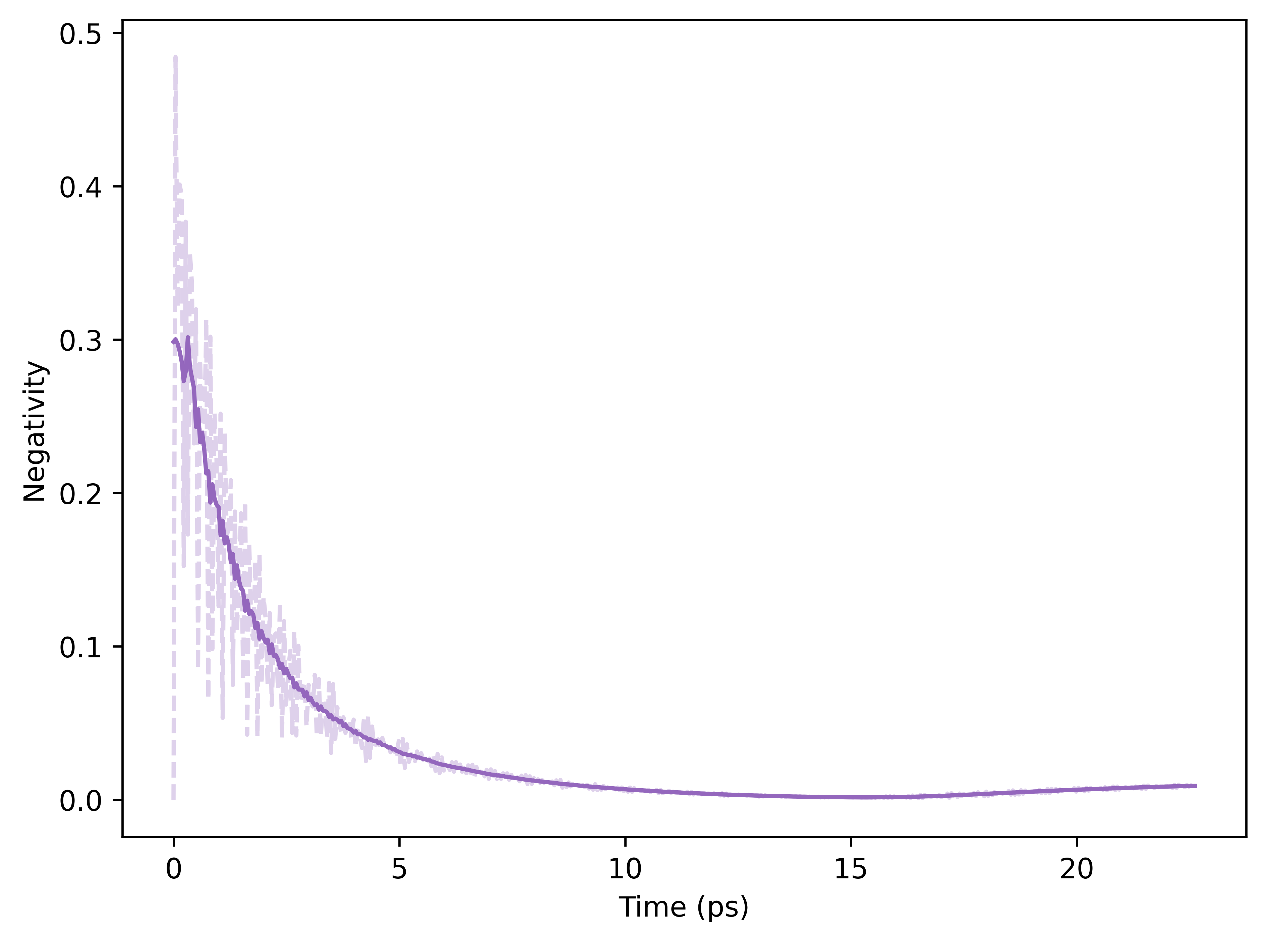
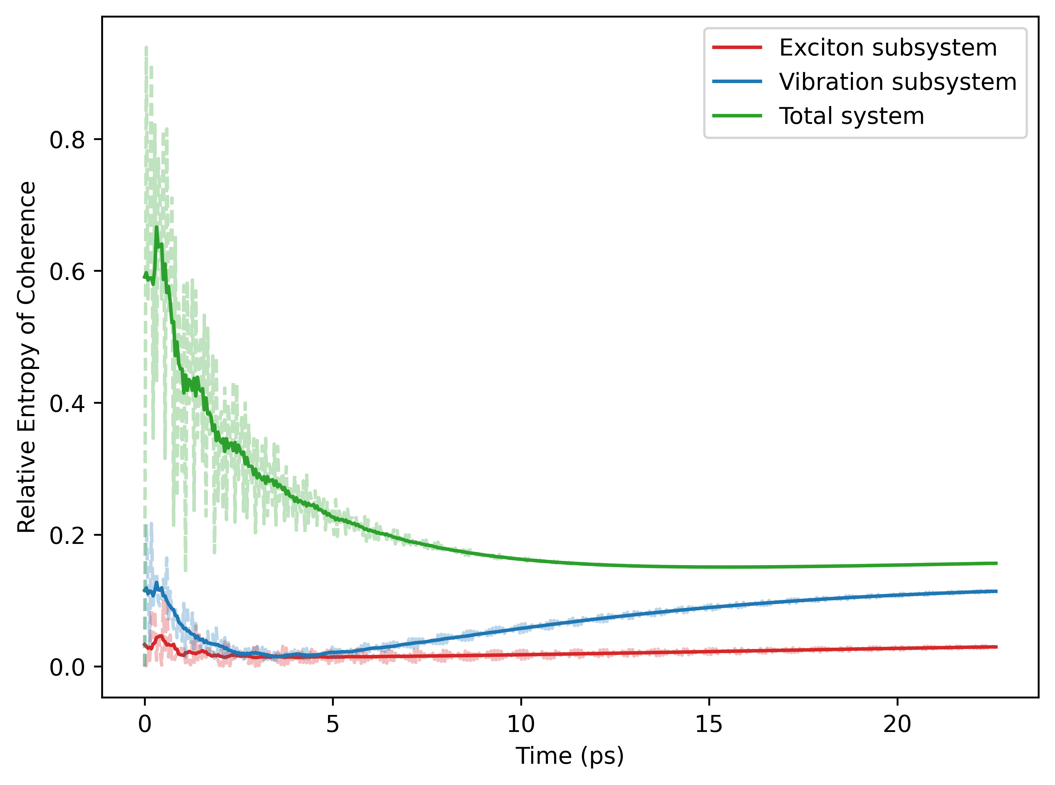
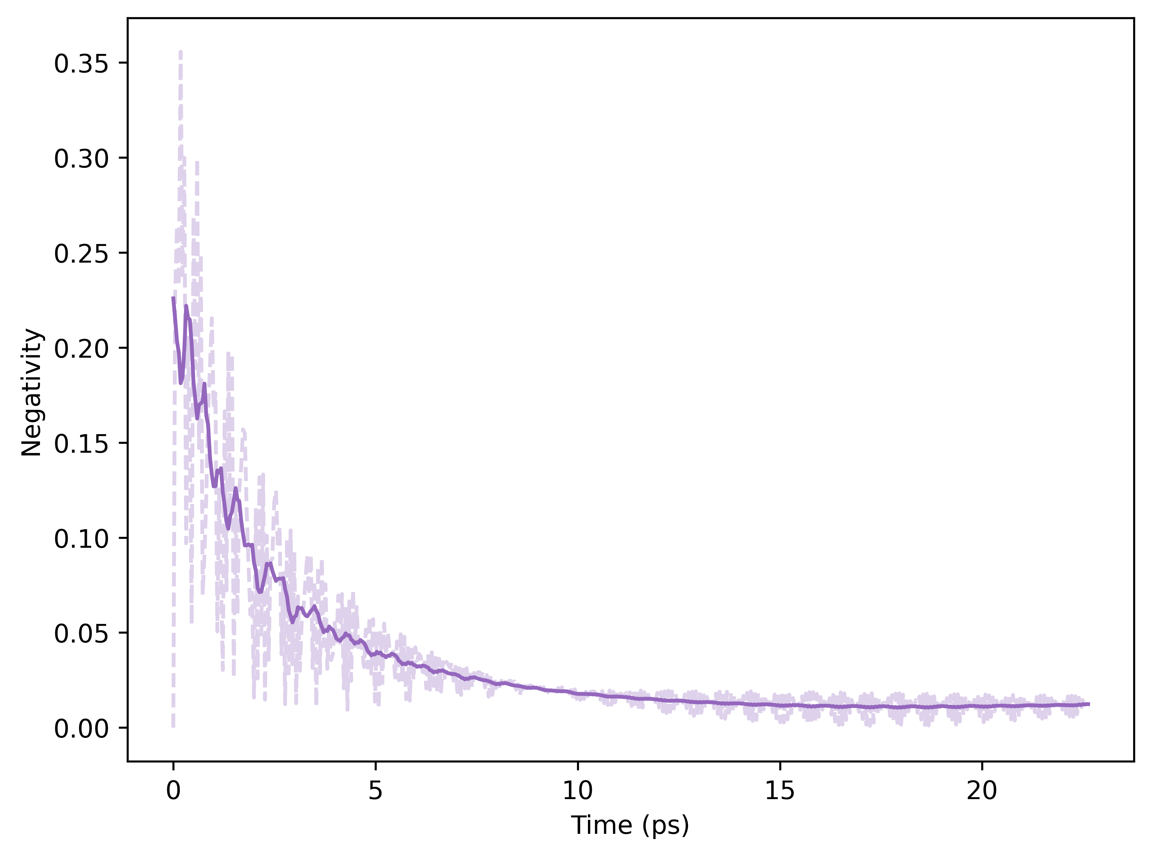
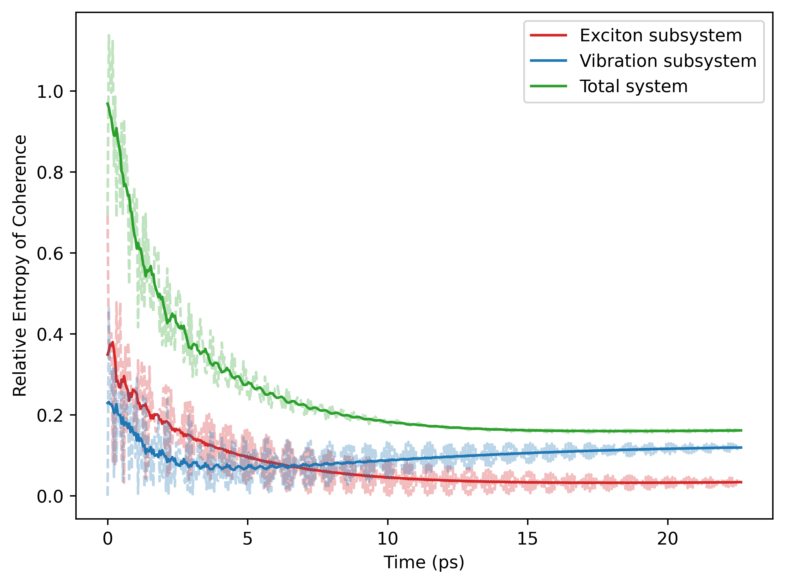
EVM: Open Evolution
Case 1:
Residual entanglement and coherence
Case 2:

Slide 13
Conclusion and Outlook
How do entanglement and coherence manifest in TLS-QHO systems?
Due to couplings between the two subsystems.
Entanglement is more fragile; decays roughly twice as fast under open dynamics.
Sensitive to initial conditions.
Trade-off between the two resources.
Higher temperature environment/bath may yield residual entanglement/coherence.

Slide 14
Thank you for listening!

